Slide 1


Slide 2

Part 1 – Transforming Power
The Call to Share together in Worship as an
act of Humble approach
Call to Worship:
One God of the vulnerable and the powerless, You created something from nothing
Many Bring Life in the places we do not look for it.
One God of the humble and frail, You turn our weakness into your building blocks
Many Bring Strength to possibilities and Depth to transparent visions.
One God of the margins and outcastes, You are crucified with those who suffer
Many Rise to Life in this, your world, your people, your creation.

Slide 3

Hymn
CWM Assembly Theme Song: Rise to Life
(Kevin Nana Moses and Lester Lewis)
https://youtu.be/AWcbHNUdBO4
Chorus
Rise to life, more abundantly
Rise to life, life eternally
Rise to life, life everlasting
Let all God’s children rise to life
1. Come on my brothers and sisters
Let us put faith in action
Let us break out of Babylon
Arise and bring transformation
2. Together we’ll build safe spaces
and life-giving communities
Free from all human atrocities
and death-dealing systems
3. Christ Jesus calls the holy church
Go and make radical disciples
Who will preach and teach fearlessly
Right in the middle of Babylon

Slide 4
Excerpt From the 2024 Assembly Statement – On “Transforming Power”
Transforming Power (2 Voices)
It is not true that market forces hold supreme authority in the human community.
This is true: “You cannot serve both
God and money” (Matthew 6:24).
Rejecting the idolatry of wealth and
power, disciples seek justice, com
passion, and righteousness.
It is not true that the powerful are entitled to attack, subjugate, colonise or enslave their neighbours.
This is true: We are morally obliged
to make reparation for historic
wrongs and to actively resist and
dismantle all forms of coloniality and
enslavement.
It is not true that women must occupy a secondary and subordinate role in church and society.
This is true: God calls women to
leadership in mission and calls
everyone to practise gender justice
and equity to effect transformative
change in every aspect of life.
It is not true that migrants and refugees pose a threat and deserve hostility.
This is true: We are called to offer
hospitality to strangers (Hebrews
13:2) as we work for justice and
dignity with all who are marginalised
and vulnerable.
We are called to be agents of transformation, resisting oppressive powers, and embodying alternative ways of living and being.

Slide 5

Message from CWM General Secretary
Rev. Dr Jooseop Keum
https://youtu.be/S86FSeZFN4s
Opening Litany - Transforming the Powers of the World
When bombs whistle through the air towards families
Let us offer our homes as shelters
When bullies target the defenceless
Let us stand in solidarity
When money buys acts of hate and terror
Let us share all our gifts
When we are told to be productive for reasons of greed
Let us spend our energies on building relationships of care.
God of all power and God who chose to give up all power
Teach us to be vulnerable for the sake of the world you love.
Grant us hearts of compassion for those in need.
Help us recognize our longings for stability and for power
And grant that we may grow in humility and compassion.
May we become clay in your hands, ready to be transformed by You!
Amen.

Slide 6
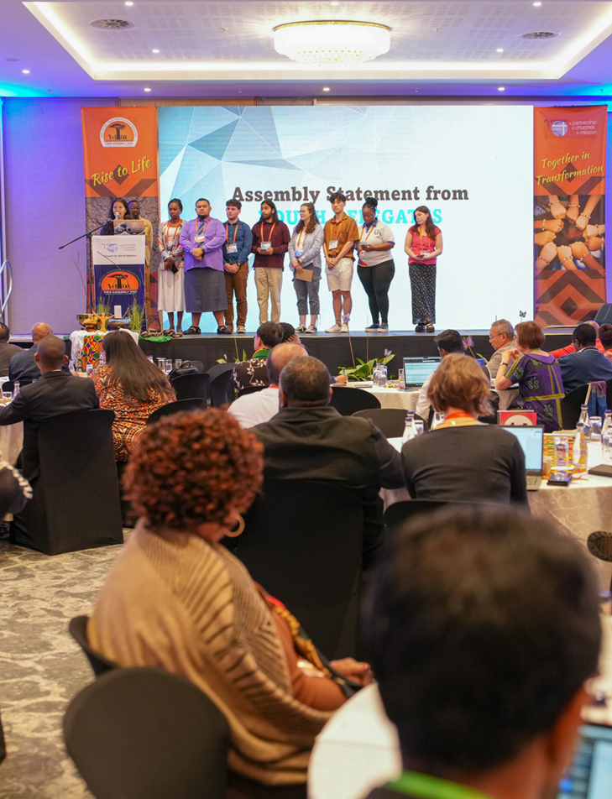
Youth Voice (Youth are invited to make a Response or Reflection on the Statement from
Youth Pre-Assembly, Durban 2024)
This is an excerpt from the Statement made to the CWM 2024 Assembly by the Youth Participants:
We have come to this Assembly to answer to this call and let our prophetic voice be heard.
Discerning the signs of the times as youths
We the youths, in discerning the signs of the times, observe many pressing issues, the biggest three being apathy towards religion in youth, inequality and the climate crisis.
Apathy for Religion
Instead of “believing in God” or not “believing in God”, most of our generation choose to not care either way, with apathy towards religion. Losing the meaning given through Jesus, the result is a rising mental health crisis amongst the youths of the world who have to deal with a completely new way of social life through the internet, leading to anxiety, loneliness and depression.

Slide 7
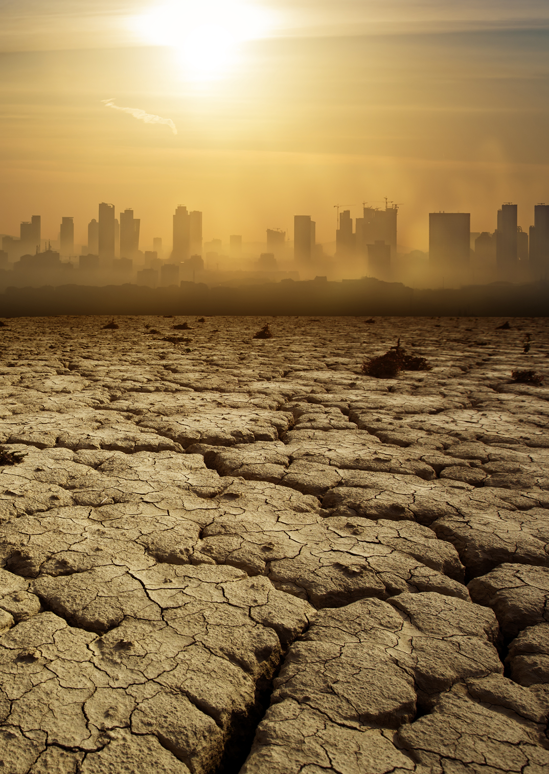
Inequalities
There are also worldwide inequalities that need to be addressed, There is an increase in the disparity between the rich and poor. This inequality manifests differently in each region, but worldwide injustice is seen with the treatment of the homeless, the refugee, the marginalised, the poor, and the oppressed. Also xenophobia, racism, sexism and other life-denying systems of oppressions have no place in our society or church, but they are nevertheless prevalent.
People abandoned by the church and wider society with no support are
dying, yet all of us seem to be preoccupied with caring only for ourselves.
Why do these issues remain in the church when we are taught that Jesus
loves and we Christians should love? We are taught to love but not how to
love; we are told to stand up for justice but not how to do so. Wider society
is apathetic to the needs of others, preferring to please oneself or one’s
personal community, consuming for themselves regardless of the harm it
does to others.
Climate Change
This is at its clearest when observing the environmental degradation in the
Pacific region and beyond. We are all taught to fight against climate change,
most of the world knows that there is a climate crisis; however, is there
anything significant being done to combat this? Not enough from powerful
governments, but also not enough from our church. At current trajectories we youth will live to experience a refugee crisis as over a billion people will live in wetbulb zones where it is impossible to live, even in shade, without artificially cooled environments. When we are your age, the world will be completely different to how it is now. With no changes it will be worse but with your guidance we can build a world that can sustain future generations.

Slide 8
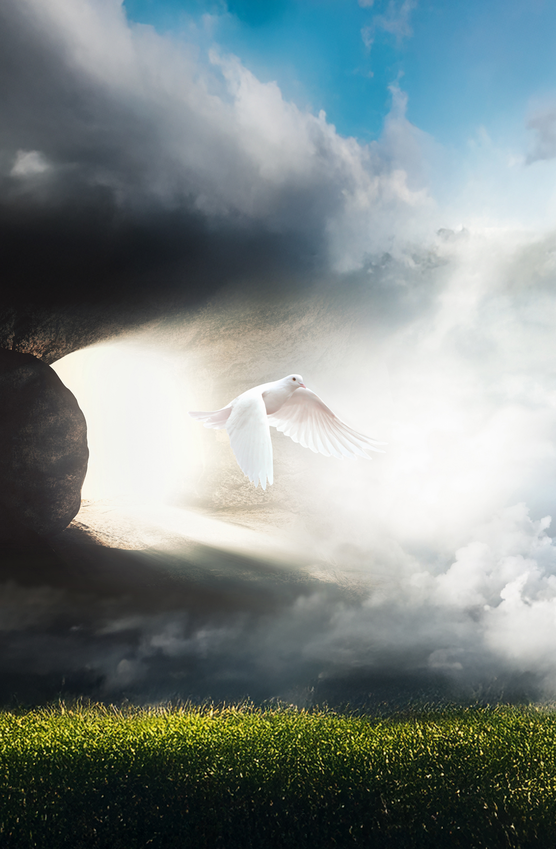
Call to action
We the youths call upon our churches to take actions in making the changes necessary in the face of the challenges of our time:
We call on our churches to act out of love and hospitality through sending missionaries to other parts of the world, and giving support generously wherever injustice and oppression occurs.
We call on our churches to open up themselves to be attentive and accommodating to the needs of our communities, and to encourage an open space and discussion for everyone through enhancing the church’s presence and engagement with the youths in person and digitally.
We call on our churches to address the issues of self-interest and financial
mismanagement that lead to economic injustice. We call on our churches to address the issues of environmental neglect that leads to unsustainability.
We call on our churches to reject harmful, anthropocentric, and authoritarian forms of theology that only serve to permeate life-denying systems.
We call on our churches to inspire and equip our youths to pursue the biblical calling for justice through sermons, social media, and various events and conferences, and support our youths to transform justice-seeking objectives into practises and actions.
We call on our churches to have more cross-regional gatherings to track the progress and changes that have been made, to solidify the relationships that are built, and to learn and encourage each other.

Slide 9
Part 2 – Fresh Visions of Mission
Our Churches are re-imagining the Kin-dom of Heaven
Song: Where The Wild God Is
https://vimeo.com/showcase/10628224/video/863875837
Readings
Option 1: Luke 10:38-42
Option 2: Colossians 1:15-28
Sermon
(It is recognised that in different settings, the preacher may choose either of the two suggested lectionary readings. It is suggested that the sermon lead into a time of reflection about local mission examples and some reflective questions.)
Stories to Share
(insert examples from your local mission setting)
Questions for Reflection
When you hear the needs in our community, who do you pray for?
When you hear the stories of God at work in our community,
what do you pray for?
When you consider God’s call to mission, what will you do?

Slide 10
Song: In Christ Alone (Adapted words for CWM Sunday)
https://www.youtube.com/watch?v=veTtpY0hycQ
In Christ alone, our hope is found
Christ is the light, the strength, the song
This Cornerstone, this solid ground
Firm through the fiercest drought and storm
What heights of love, what depths of peace
When fears are stilled, when strivings cease
Our Comforter, our All in All
Here in the love of Christ we stand
In Christ alone, who took on flesh
Fullness of God in helpless babe
This gift of love and righteousness
Scorned by the ones God chose to save
‘Til on that cross as Jesus died
The gift of grace was satisfied
For every sin on Christ was laid
Here through the death of Christ we live
There in the tomb Christ’s body lay
Light of the world by darkness slain
Then bursting forth in glorious Day
Up from the grave Christ rose again
And as Christ stands in victory
Sin’s curse has lost its grip on me
For belong to God alone
Bought with the precious blood of Christ
No guilt in life, no fear in death
This is the power of Christ in us
From life’s first cry to final breath
Jesus commands our life be just.
No power of hell, no human scheme
Can ever shake us from God’s team
Till Christ comes and Heaven fulfilled
Here we will work for God’s promised dream.

Slide 11
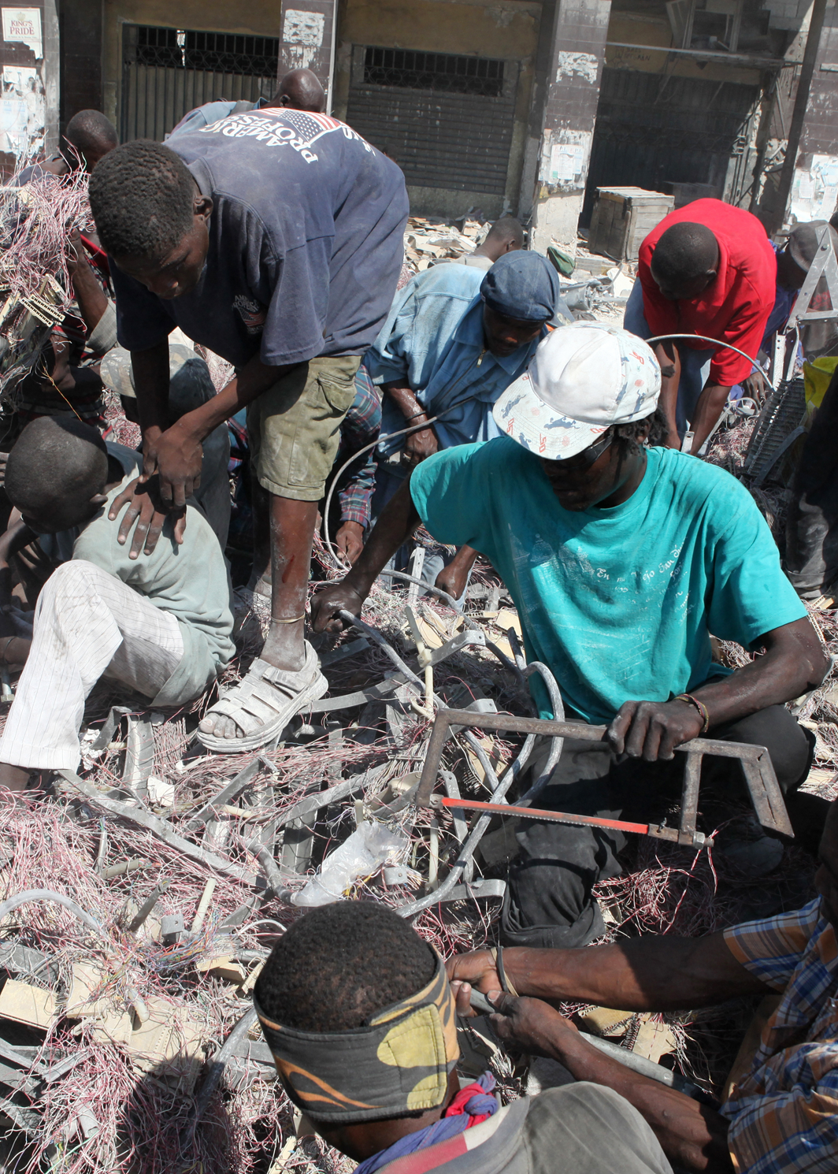
Special Offering
For Vanuatu’s recovery from a devastating earthquake last December
and subsequent aftershocks. https://youtu.be/4kmYY3aS7XA
On 17 December, 2024, a 7.3 magnitude earthquake destroyed multiple
buildings in Port Vila, Vanuatu. The earthquake claimed 12 lives, with more
than 200 people injured. The Port Vila central business district was seriously
affected, with the demolition of buildings required. Businesses and schools
continue to face serious logistical challenges. Thousands of residents in and
around Port Vila had to relocate, with some communities possibly facing
permanent relocation to new, safer sites.
Offering Prayer
God of all creation.
When the earth was formed, you were there.
When the earth crumbles, you are there.
When all of creation is repaired and renewed, you will be there.
Comfort the people of Vanuatu, continuing to strive for recovery
following earthquake.
When the shaking has ceased and images of destruction are replaced
by signs of life,
Console those who continue to mourn and comfort those who live with
trauma.
When the rumblings of life changes come our way,
may we be generous in offering your signs of love and blessing.
AMEN

Slide 12
Part 3 – Praying for Life-flourishing Communities
Commitment to Life-Affirmation
We believe the mission of God for this world
Is to bring forth life and cause it to flourish.
We believe the God of mission has a Church
To work for resurrection and restoration and the renewal of all things.
We believe this partnership of missional churches
is empowered by the Spirit of God for the work of transformation.
We believe that the seed of transformation is already planted
And we will see the fruits of God’s love for the world.
We commit ourselves to working together
to transform the powers of this Kingdom
for the sake of the eternal Kin-dom!
Praise be to God – who lived, died and lives again!
May we offer a foretaste of life-flourishing in the world.
Alleluia! Amen!

Slide 13
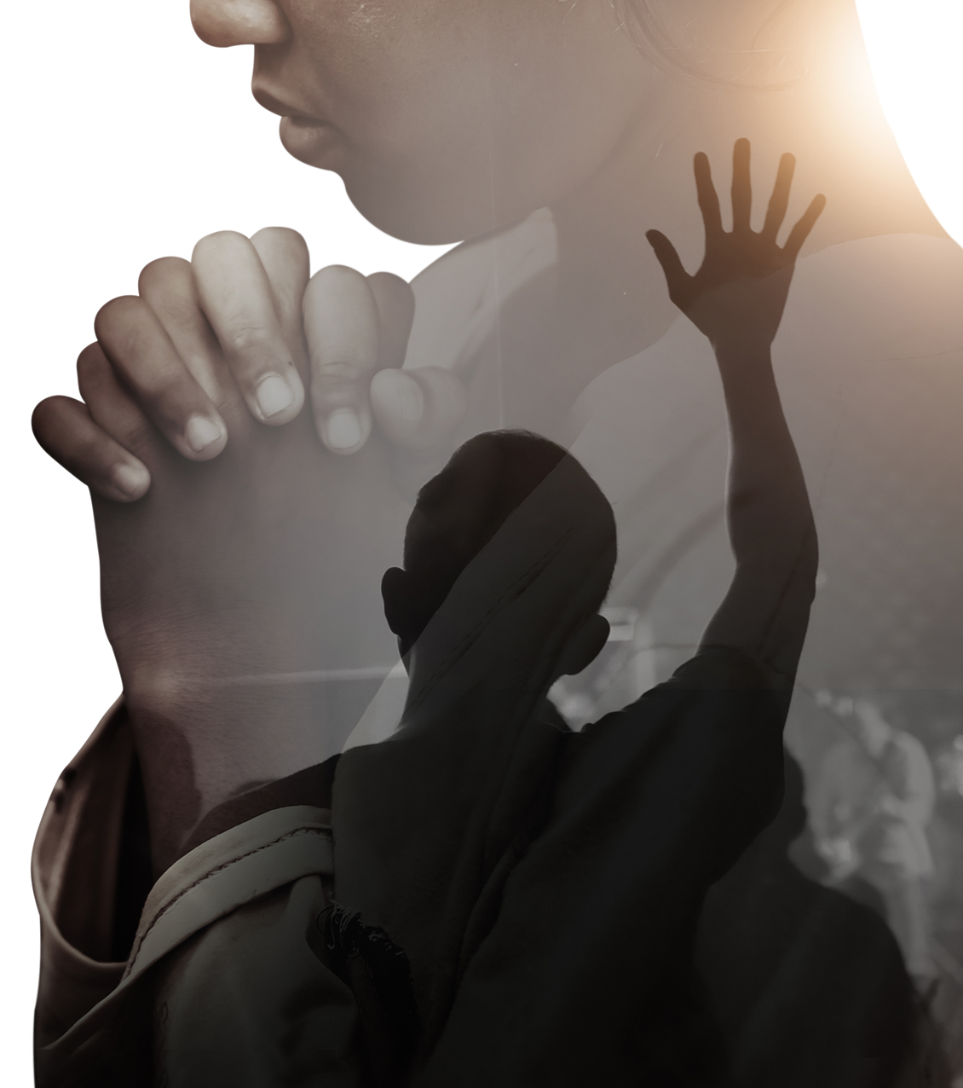
Hymn (Tune: Lobe den Herren)
NEW WORDS – written for CWM Sunday 2025
https://www.youtube.com/watch?v=zW6Vv5z8U8s
Praise to the Christ, who has humbly come into creation!
O my soul, praise him, for he is the means of salvation!
All we who hear, now to Messiah draw near;
join us in glad adoration!
Praise to the Spirit, who gives breath for our very sustaining.
Sharing our prayers, we commit to this Spirit’s maintaining.
God’s care enfolds those who true justice uphold.
Advocate for life’s reframing!
Praise to the Shepherd, whose voice calls our names to the table
surely this goodness and mercy gives strength and enables.
Ponder anew what, as God’s people, we do,
Bearing Christ’s name as our label.
Witness to God – let us worship the God of transforming.
Human-Divine, God calls us to be always reforming.
Let the amen sound from God’s people again;
gladly forever adoring.

Slide 14
Prayers of Intercession
God of grace and mercy,
We come before You with hearts full of hope and faith,
lifting up our prayers for the world.
We seek peace for all nations embroiled in war and conflict.
May Your peace prevail and put an end to violence and turmoil.
Grant wisdom and understanding to the leaders of the nations,
so they may govern with righteousness and justice.
By Your Spirit, let fairness and equity be the bedrock of all societies.
Strengthen the economies of nations grappling with poverty.
Provide opportunities for growth and economic stability.
Protect the poor and vulnerable in every country, O God.
Be their refuge and strength in times of need.
Bring an end to corruption and injustice in governments.
Raise up leaders who will govern with integrity and honour.
Let Your message of love reach every corner of the earth,
and may its transformative power bring fullness of life to all.
Grant protection to those spreading Your word in dangerous places.
Keep them safe, grant them resources and favour,
and empower their ministry.
We pray for spiritual revival across nations,
that people would turn to You and find hope and salvation.
Heal the divisions in nations torn apart by hatred and racism.
Bring reconciliation and unity among all people.
We pray for children worldwide,
that they may grow up in peace and safety,
with access to education and opportunities for their full liberty.
Bring healing to nations devastated by disease and famine.
Provide relief and restoration to those in need.
Restore the natural resources of countries that have been depleted,
and bring environmental healing to our world.
By Your Holy Spirit, may there be a revival in the care of Your earth.
God of Creation, send healing rains to nations suffering from drought.
Revive the land and provide for the needs of the people.
We trust in Your power and grace,
knowing that You hear our prayers and are at work in the world.
In Jesus’ name, we pray.

Slide 15

Blessing Song: I Believe That One Fine Day…
(A simple and upbeat round)
https://aliburns.co.uk/shop/song/downloads/i-believe-that-one-fine-day/
I believe that one fine day
I believe that one fine day
That the power of love
Will rise above the love of power
Benediction:
Let God’s Love Transform Us
to become good news for the whole created order.
Let us go into the world to love, to serve, to affirm, to empower,
to enhance justice and liberation.
May Jesus Christ our Saviour and the Holy Spirit our guide
be with us all now and forever more.
Amen

