Slide 1

Te Aka Puaho
Korowai Tapu exchange
March 2022
Music: Korowai Tapu by Malcolm Gordon
From Songs for the Saints

Slide 2
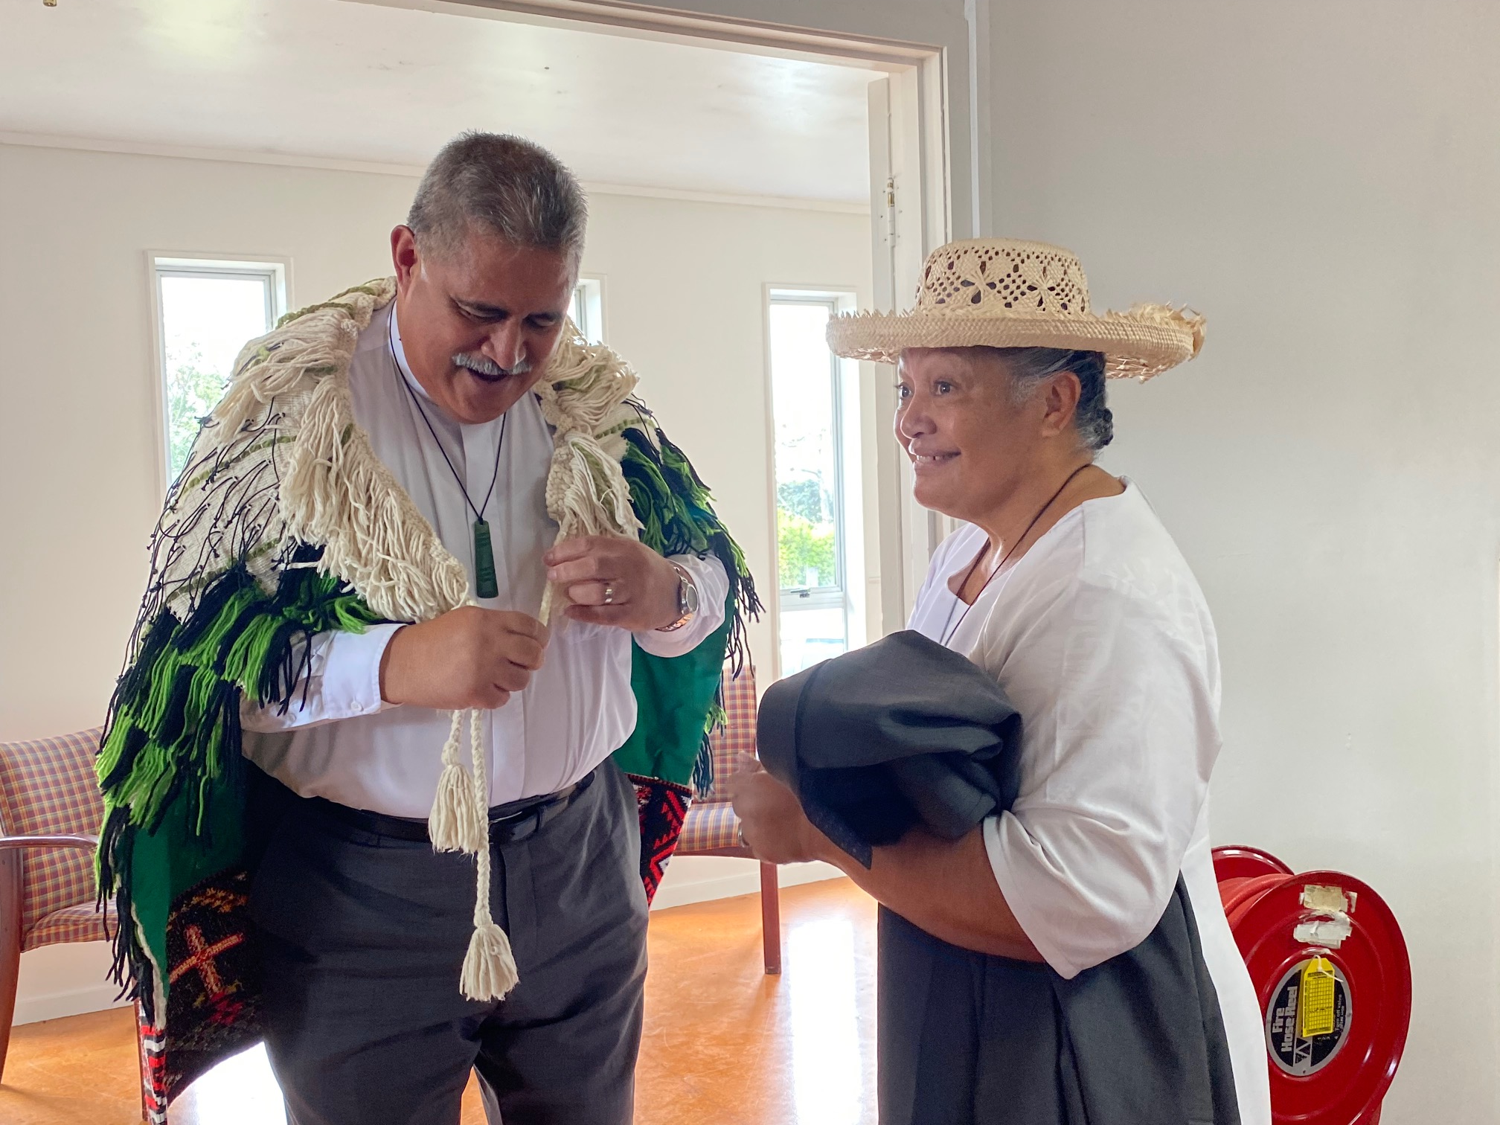
Very Rev Fakaofo Kaio with Mrs Ruth Kaio – wearing the korowai for the last time

Slide 3
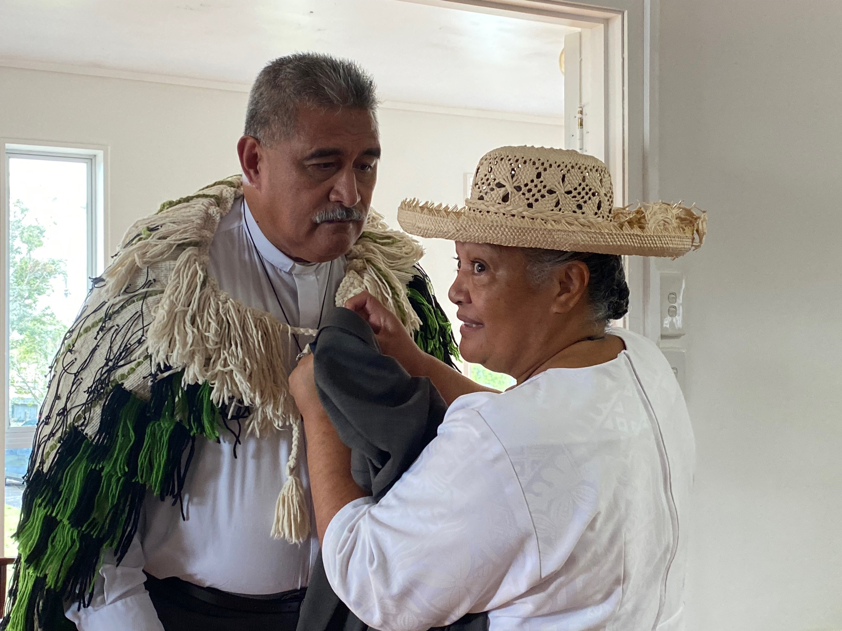

Slide 4
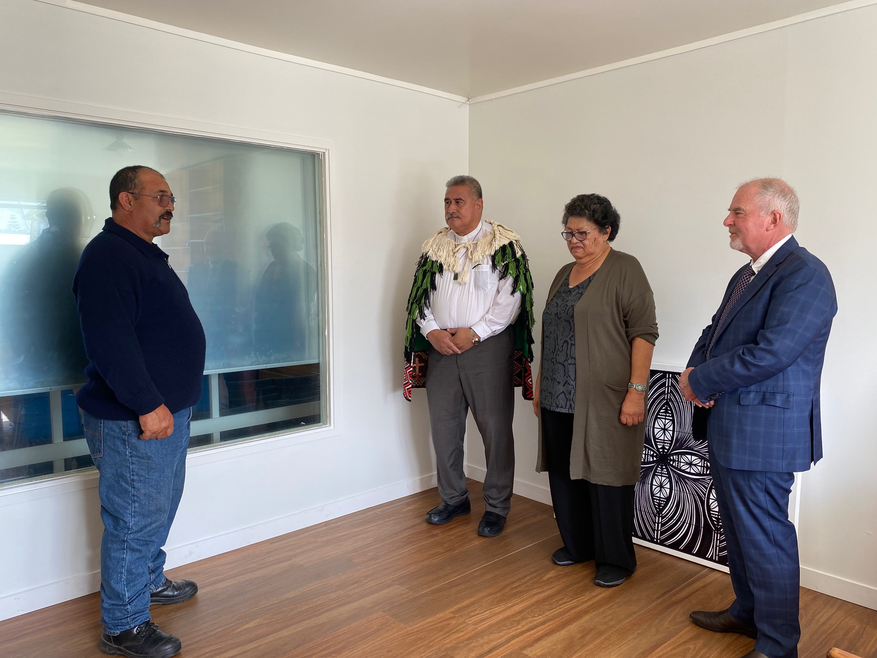
Rev Tamiana Thrupp leads a karakia.
With Very Rev Fakaofo Kaio, Ms Marina Rakuraku Moderator of Te Aka Puaho, Rt Rev Hamish Galloway

Slide 5
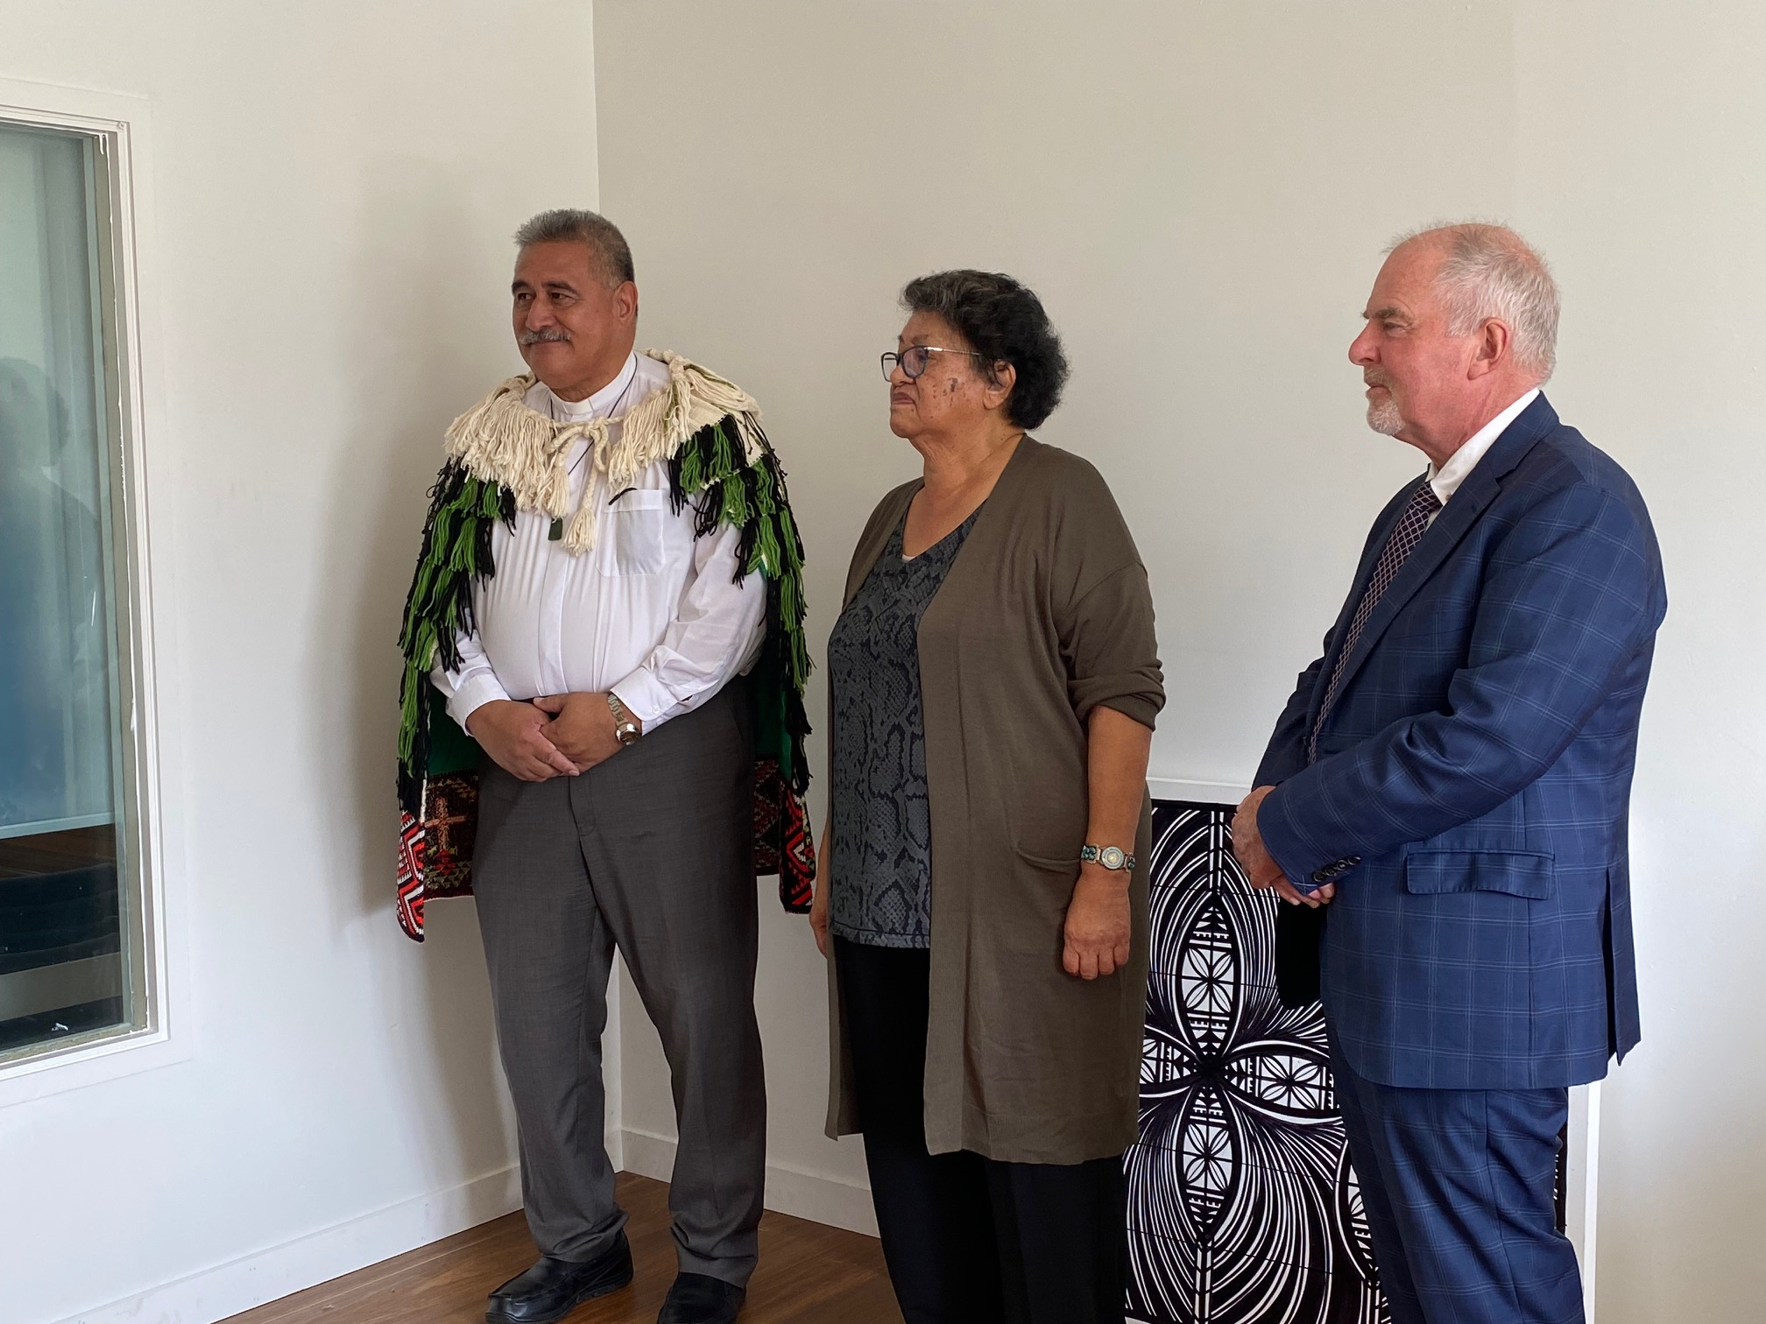

Slide 6
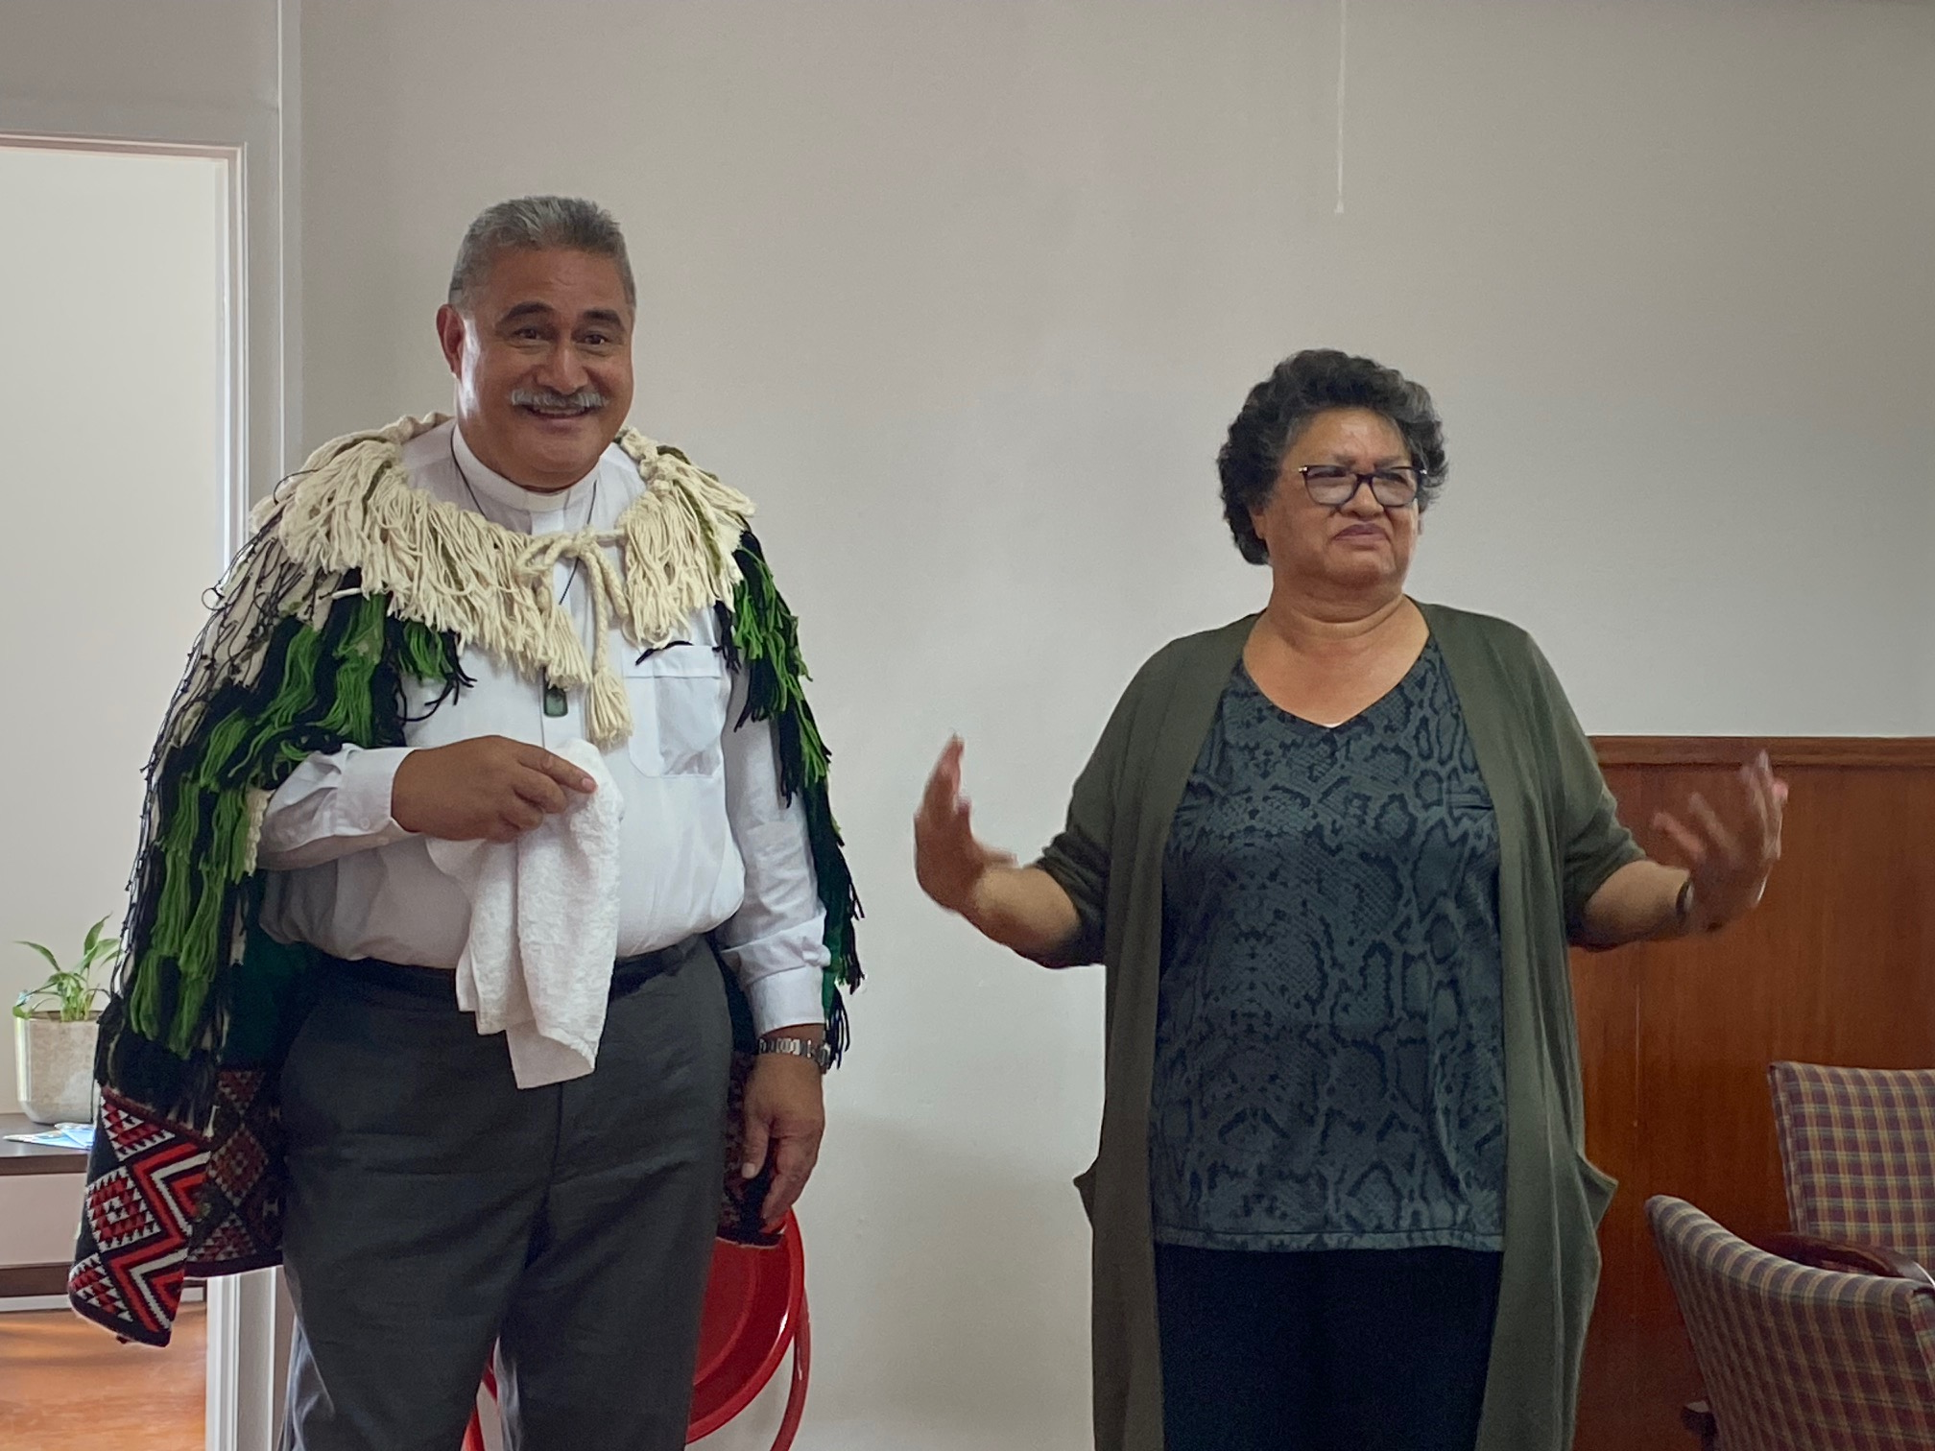

Slide 7
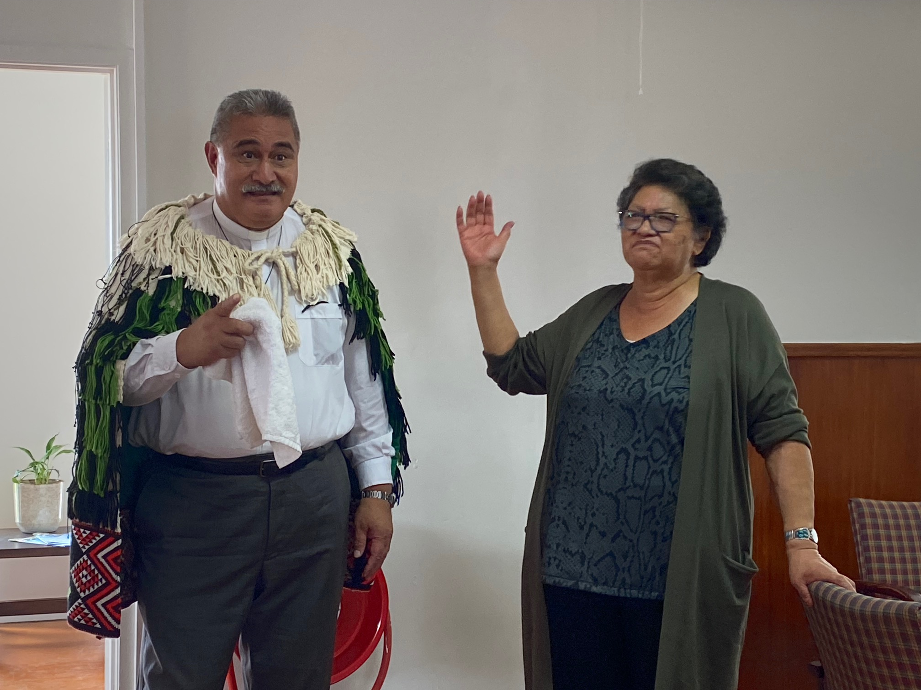

Slide 8
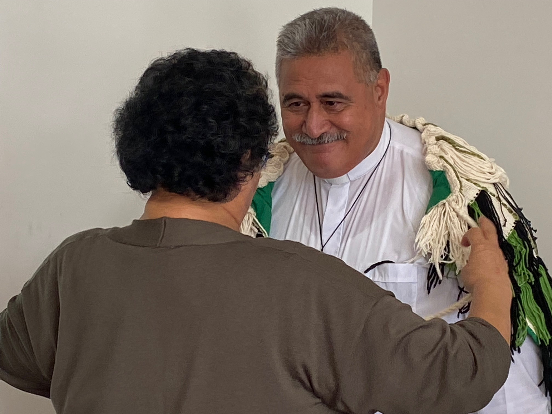
Marina Rakuraku, Moderator of Te Aka Puaho removes the korowai tapu from Very Rev Fakaofo Kaio’s shoulders.

Slide 9
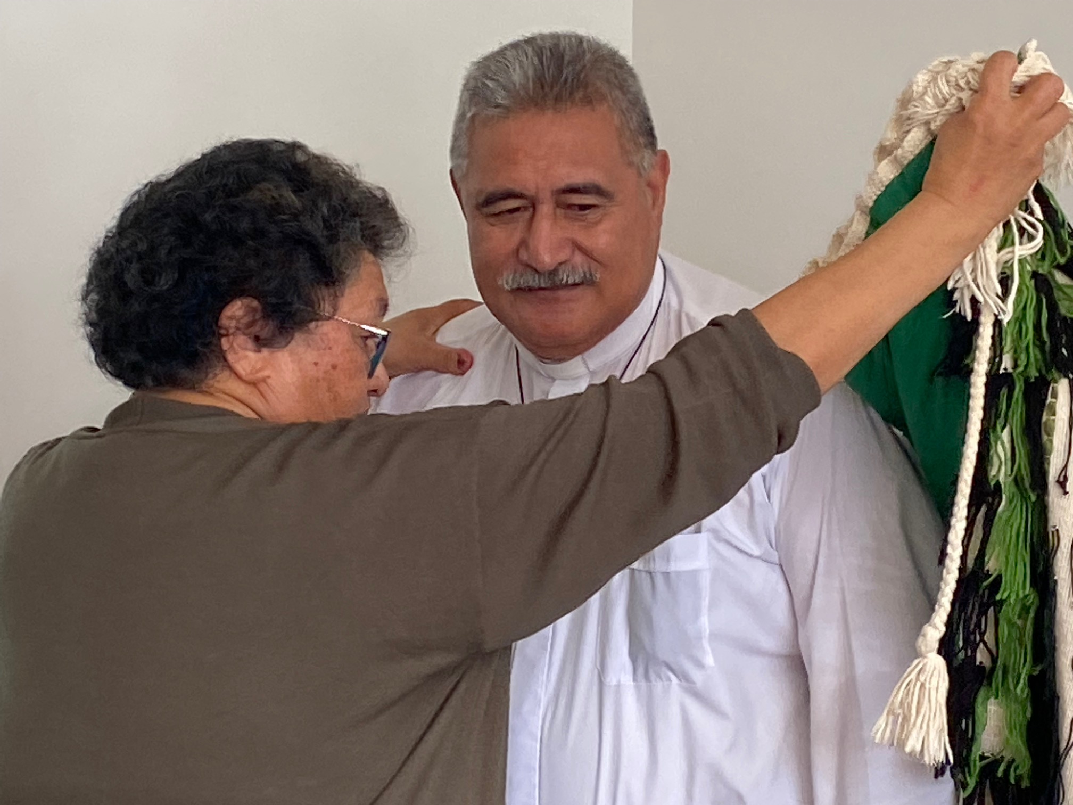

Slide 10
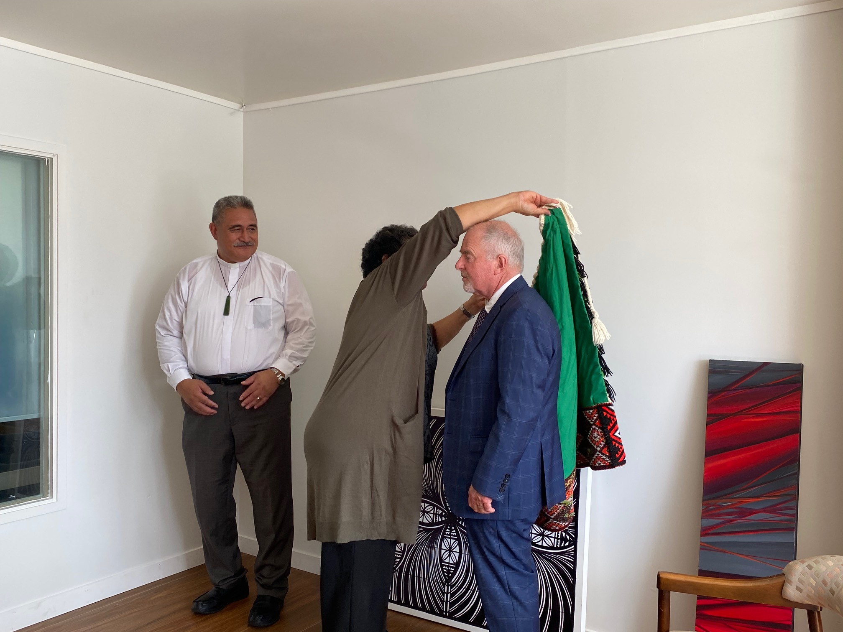
The Rt Rev Hamish Galloway receives the korowai tapu

Slide 11
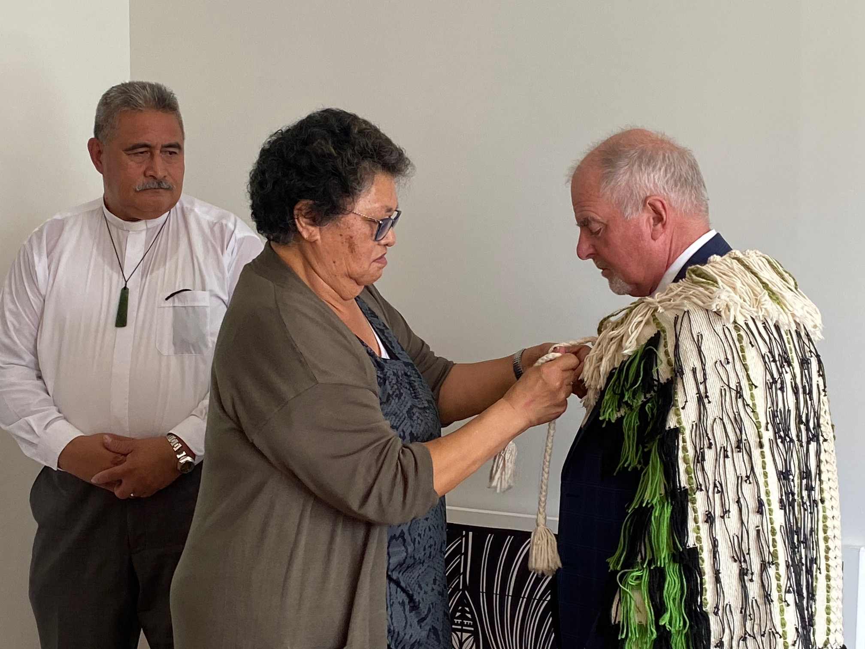

Slide 12
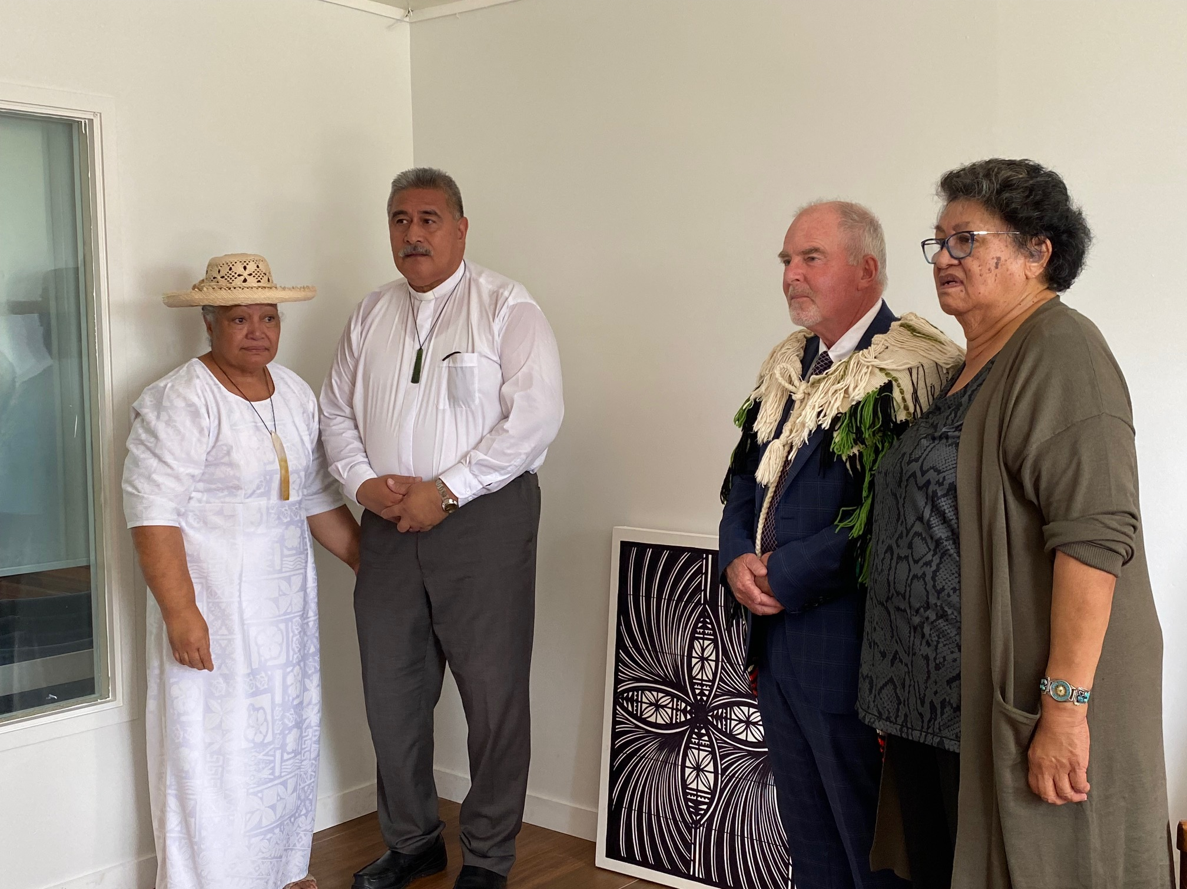
Gifts being presented to Very Rev Fakaofo and Mrs Ruth Kaio by Te Aka Puahos

Slide 13
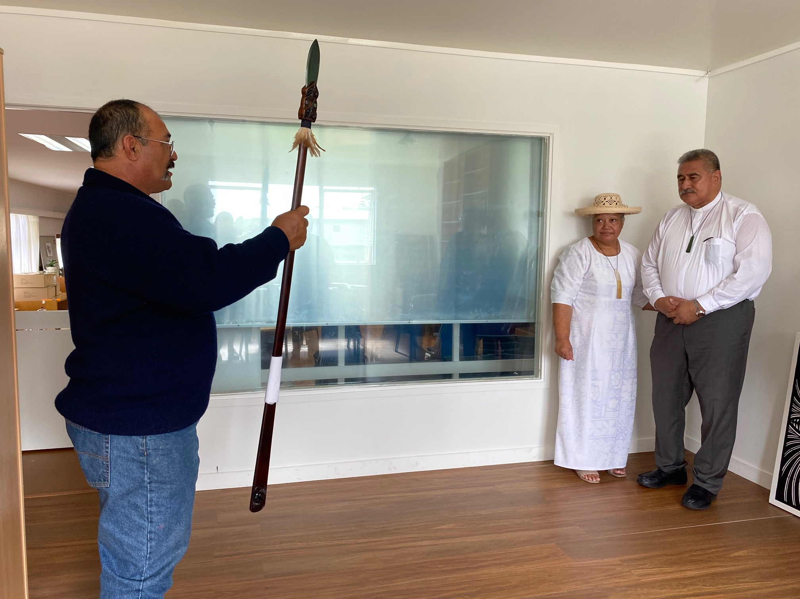

Slide 14
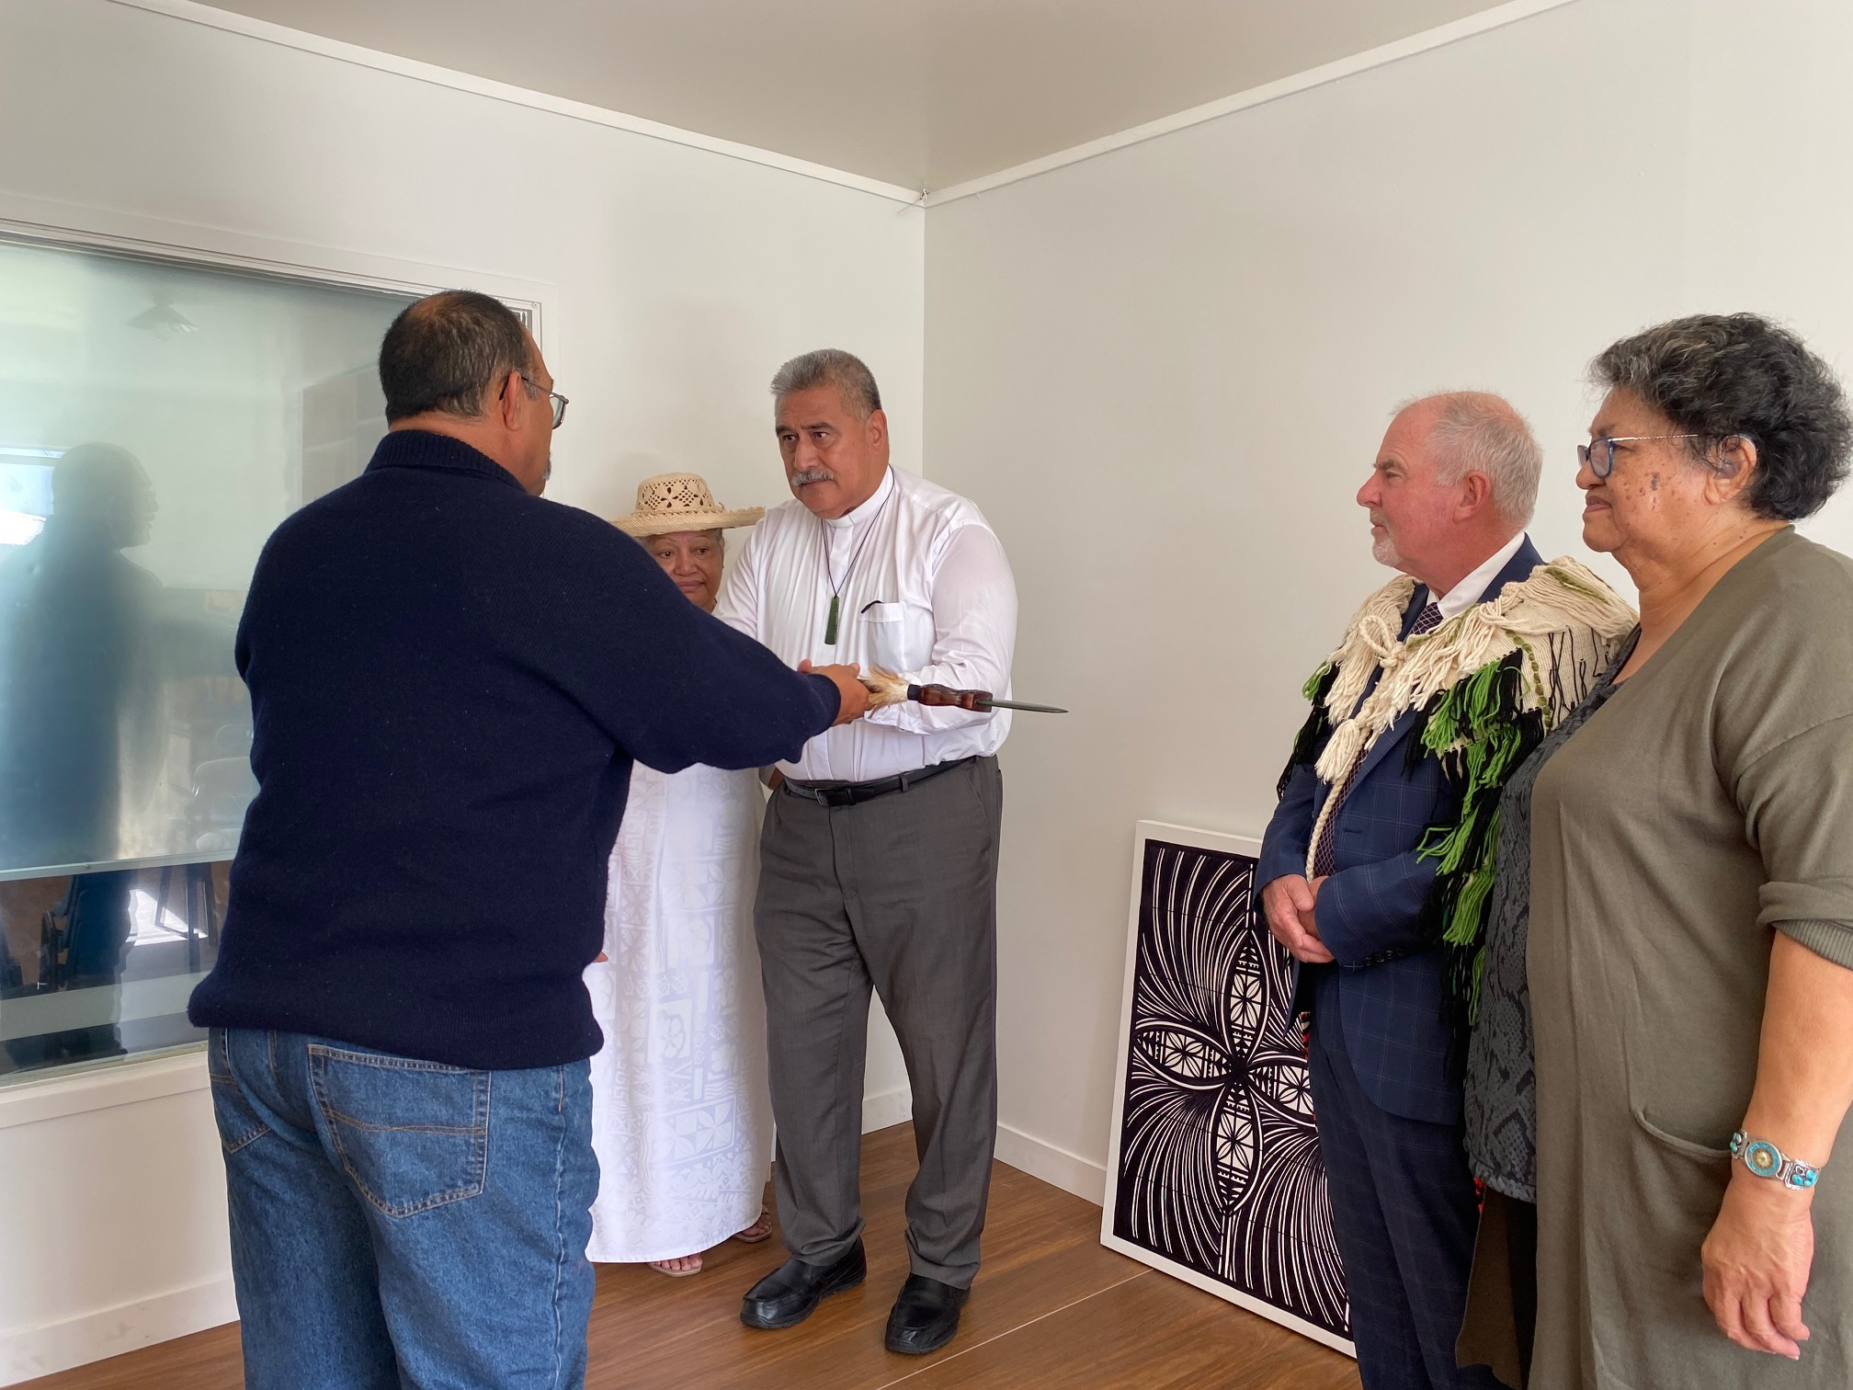

Slide 15
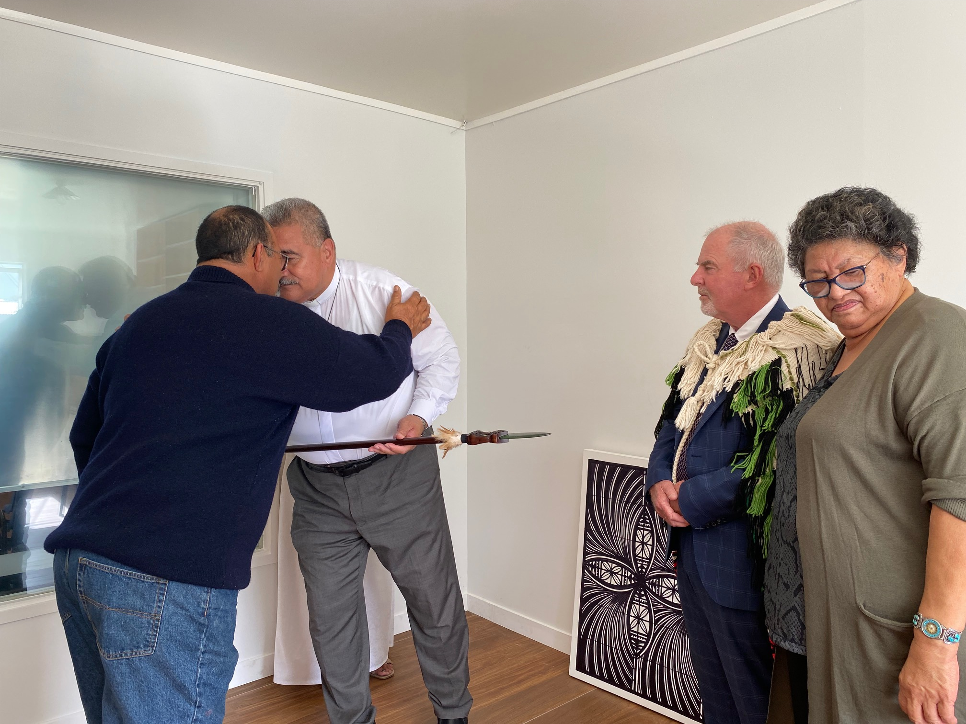

Slide 16
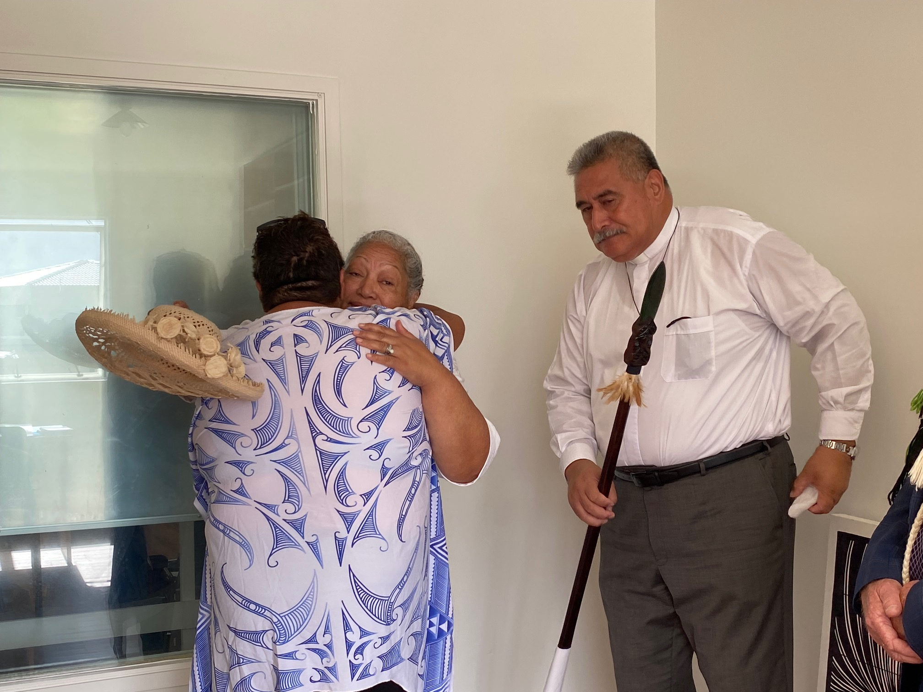

Slide 17
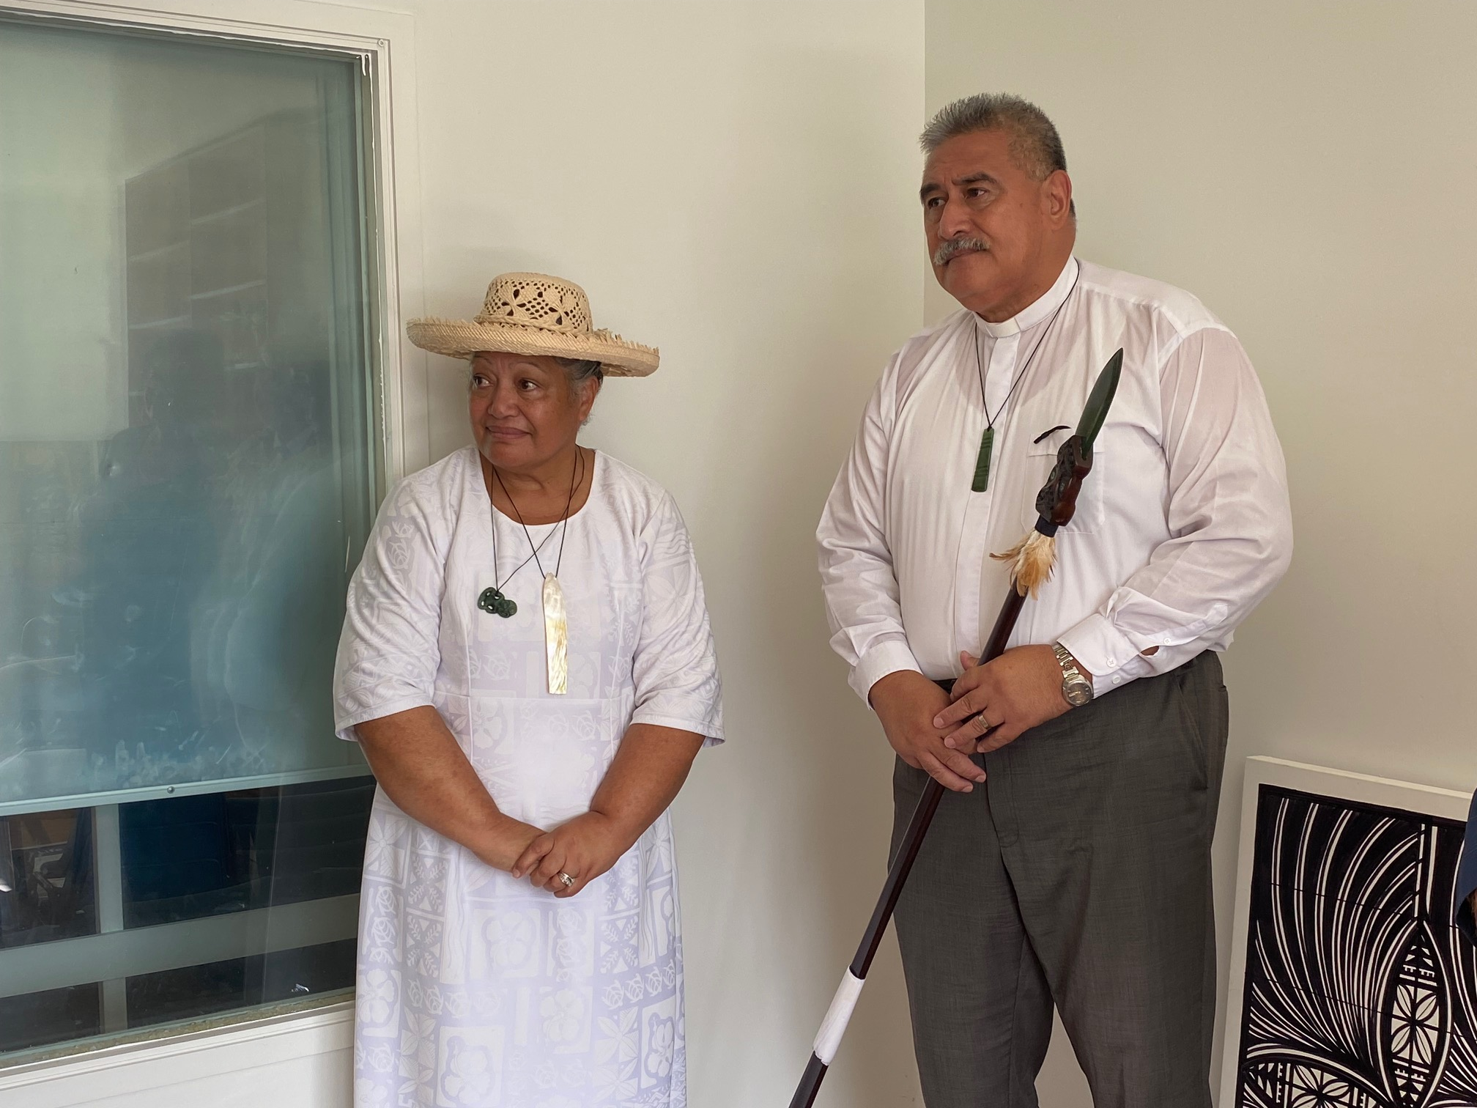

Slide 18
