Slide 1


ANNUAL REPORT HIGHLIGHTS
FOR THE YEAR ENDED
30 JUNE 2022
Music courtesy of Blue Dot Sessions: Case to Rest; Thannoid

Slide 2
WHO ARE WE?
Trustees
Ron Mills (Chair)
Andrew Souness
Roger Gyles
Margaret Galt
John Harvey
Marie Burgess
Paul Barber
Alan Jamieson
Hao Hoang
Brian Dangerfield
Winston Timaloa
Lyn Murray
Helen Carter
Rose Luxford
Associates
Colin Marshall (Council of Assembly)
Wayne Matheson (Assembly Executive Secretary)
Doug Crombie (Farms)
Ruth Rainey (Farms)
Warren Potter (Investment, Beneficiary Fund)
Ian Russon (Beneficiary Fund) (ended August 2022)
Staff
Russell Garrett (Executive Officer)
John White (Property and Administration Manager)
Tracy Setters (Office Manager)
Robyn Taylor (Accountant)
Farmers
James and Steph Carter (Glen Innis)
Keith and Jo Dennis (Flaxburn Sharemilker)

Slide 3
WHAT DO WE DO?
Property
Approves property transactions and deals with property-related concerns, e.g., Earthquake Prone Building Policy
Coordinates the work of the Trustees
Private Trusts
Insurance
Distributes bequests and estates and manages private trusts, e.g., Presbyterian Benevolent Fund
?
Oversees the Presbyterian Insurance Collective via a separate Trust
?
Executive
?
Beneficiary Fund
Audit and Risk
Farms
?
?
Manages the McNutt Trust (Glen Innis sheep and beef farm) and CA Clark Estate Trust (Flaxburn dairy farm)
Responsible for the Beneficiary Fund via a Board of directors
Investments
?
Oversees the Presbyterian Investment Fund
Oversees the audit process, the production of financial statements, and the risk framework

Slide 4













HOW DO WE DO IT?
56 Trustee and committee meetings in 2021-22 (mostly via Zoom)
127 polls (decisions between meetings)
With lots of help from our advisers and providers – thank you

Slide 5
PROPERTY
Property Transactions by number and value for 2021 and 2022
73 property approvals over the year (last year 62)
Renovations and strengthening continue to demand a lot of parish time and capital
Value $m
Over twice as many sales in 2022 as 2021, and 5 purchases in 2022 (last year nil)
The Trustees approved the sale of nearly $50m of property over the year
Number

Slide 6
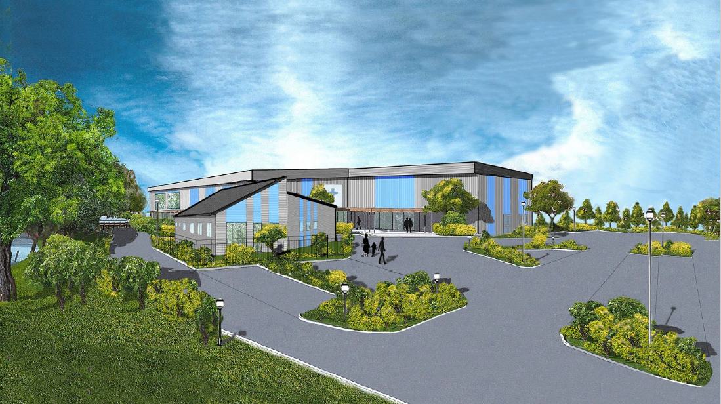
Church builds can be a major undertaking: here is a progress update from Mahurangi Presbyterian

Slide 7


Slide 8
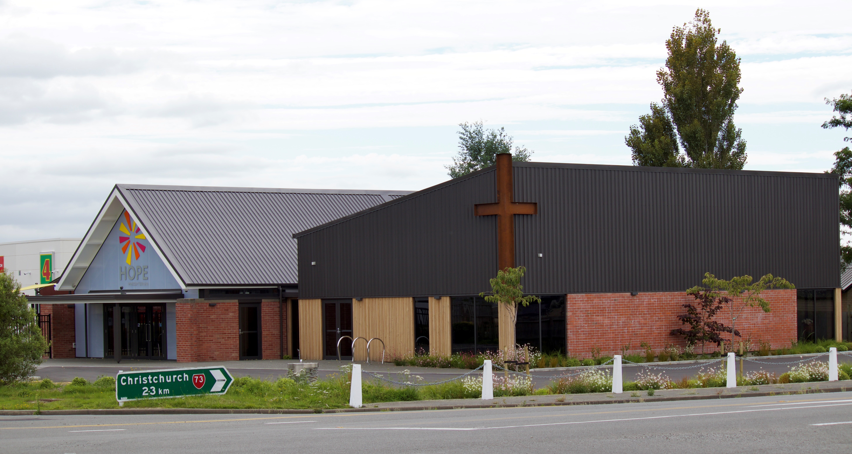
PROPERTY (continued)
We updated the Property Handbook
And held a successful presbytery property day to look at planning for fit for purpose buildings
We do not know the seismic (NBS) rating for a quarter of our buildings
Of those we know about, half need strengthening (or something else)
Despite good work by many parishes, there are still a lot of buildings that require strengthening
The new Hope West Melton complex

Slide 9
INSURANCE - COVER
The number of parishes in the Presbyterian Insurance Collective increased from 340 to 342
The sums insured also increased, although natural disaster cover is below cover for fire/perils - in part because earthquake prone buildings can’t be insured for natural disaster
Concern remains that many parishes are under-insured – some because they can’t afford it, and some because they have not revalued their property for some time
The number of parishes and the value of assets covered increased over the year

Slide 10
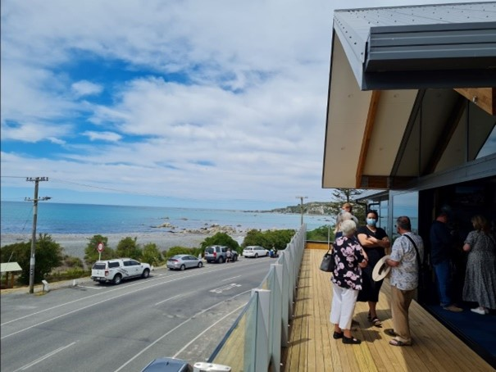
INSURANCE - CLAIMS
47 claims were made in the year to 1 August 2022, up from 34 last year
While the number of claims increased, the value of claims fell, from $2,558,000 to $349,000
There were no major claims made during the year, with the largest a claim for $58,000 for water damage (last year a claim for $2.37m was accepted for fire damage)
The Collective has asked the insurer to appoint a new national loss adjuster that it believes will provide better service
While the number of claims increased, the value of those claims fell substantially
The view from the new Kaikoura development

Slide 11
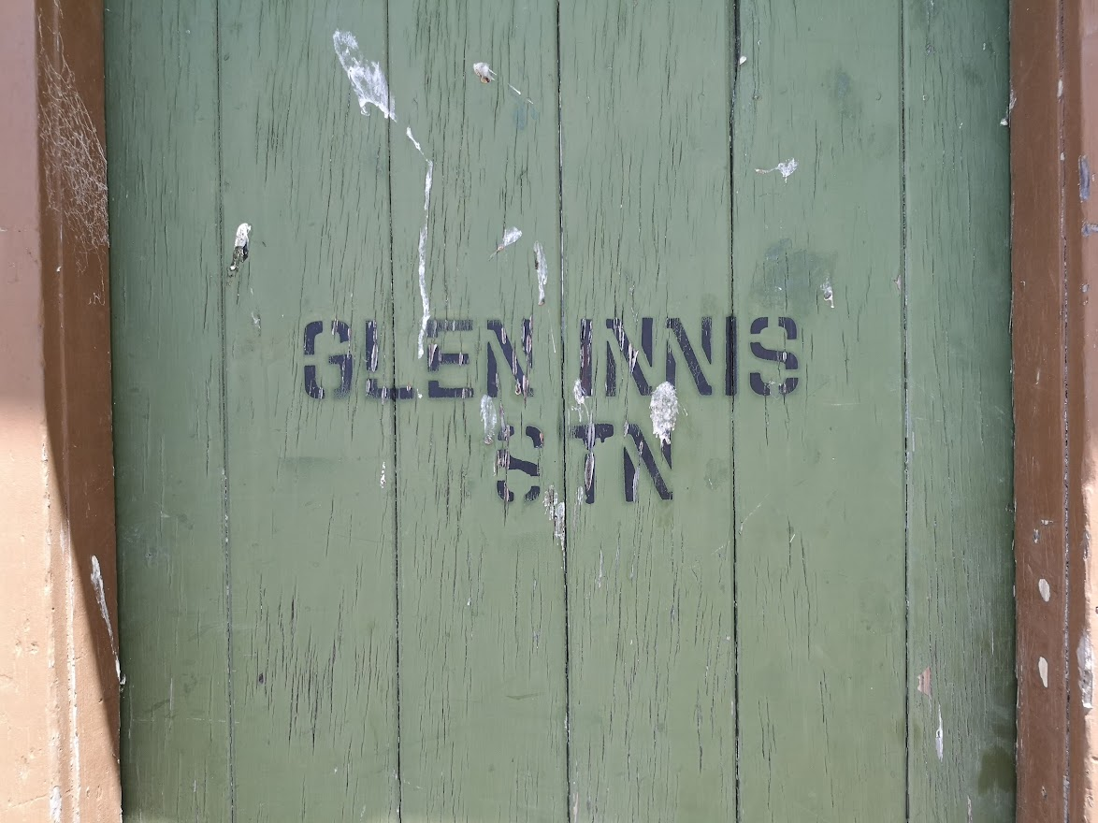
FARMS – McNUTT TRUST
Glen Innis - Sheep and Beef - Central Hawkes Bay
The primary purpose is providing holiday homes for ministers and their families
Last year the Trust also gave $3,333 each to St Andrew’s Waipukurau, EPIC Ministries, and Presbyterian Support East Coast for their work with children and young people
It was a tough year for the farm as we went from drought to flooding
Work continues to expand the farm to make it more economically sustainable – we hope to take advantage of an opportunity to sell the recently acquired Woodhill Block and purchase an even better property
Covid continues to disrupt our ability to host ministers and their families in the Holiday Homes

Slide 12
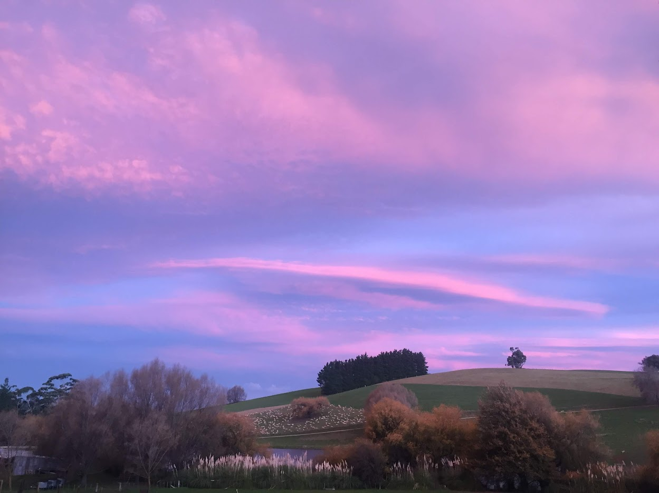
It’s usually very beautiful

Slide 13
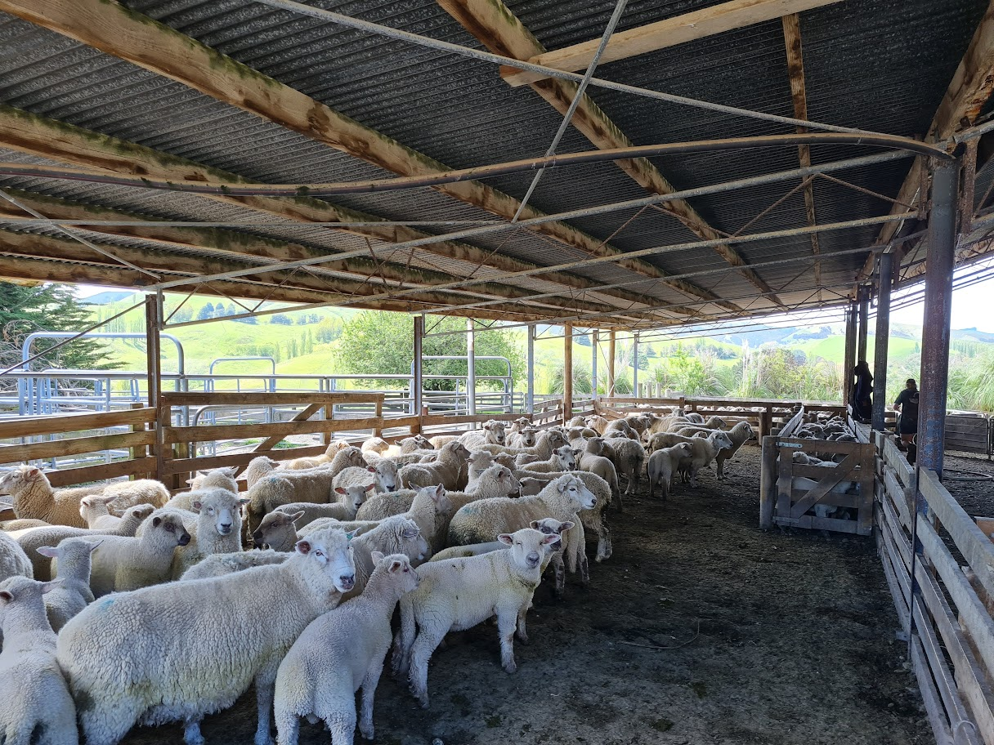

Slide 14
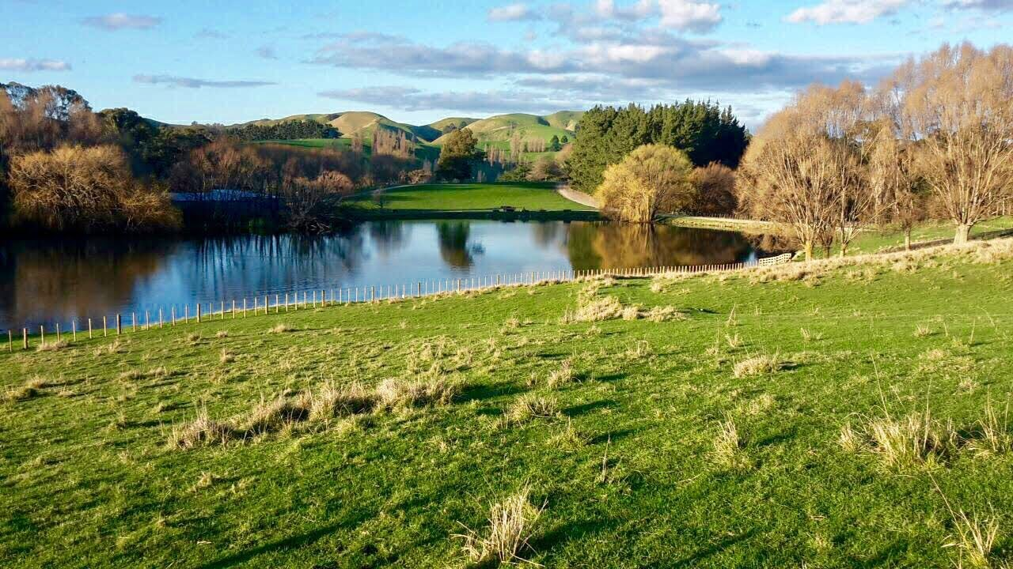

Slide 15
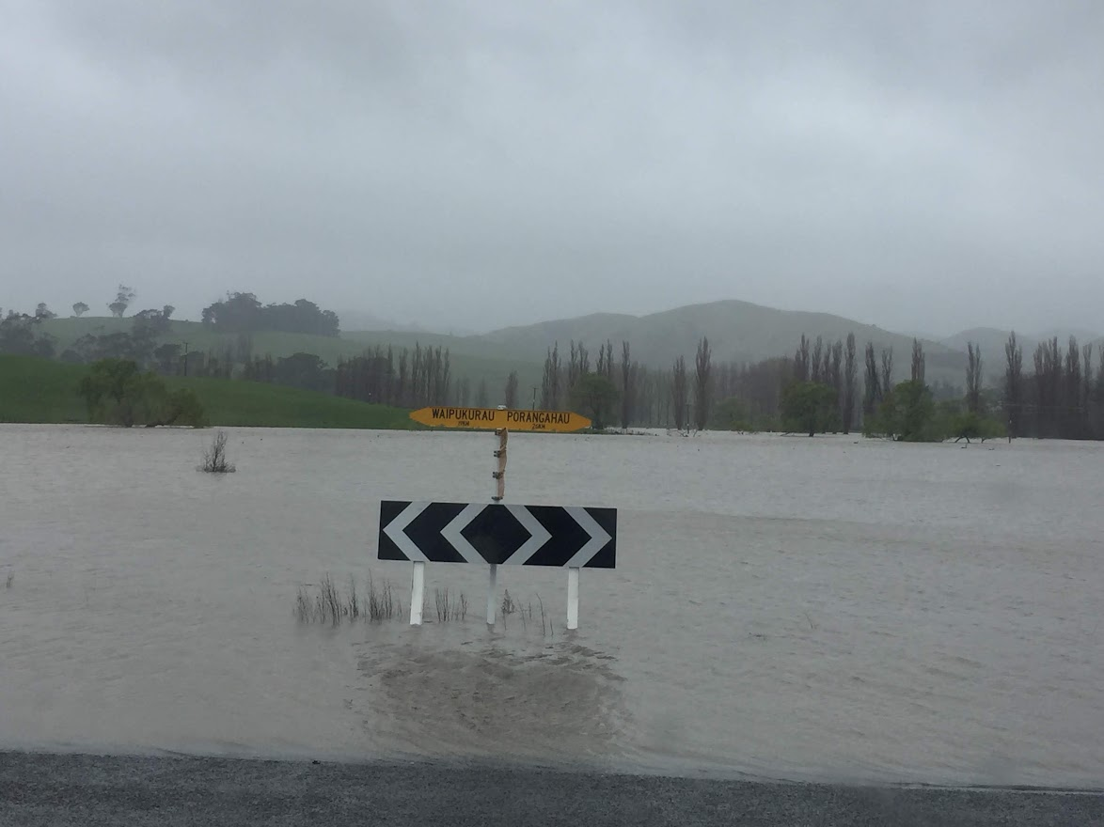
But this year there was a lot of rain

Slide 16
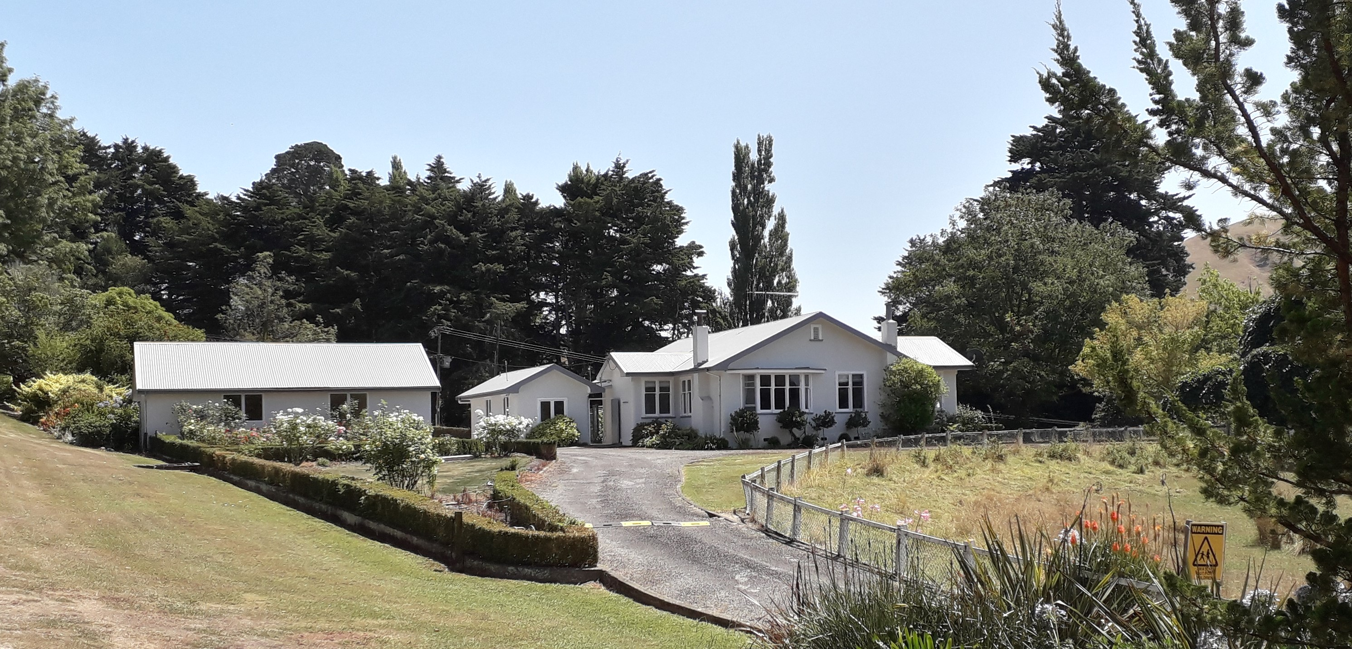
McNutt homestead (and games room)

Slide 17
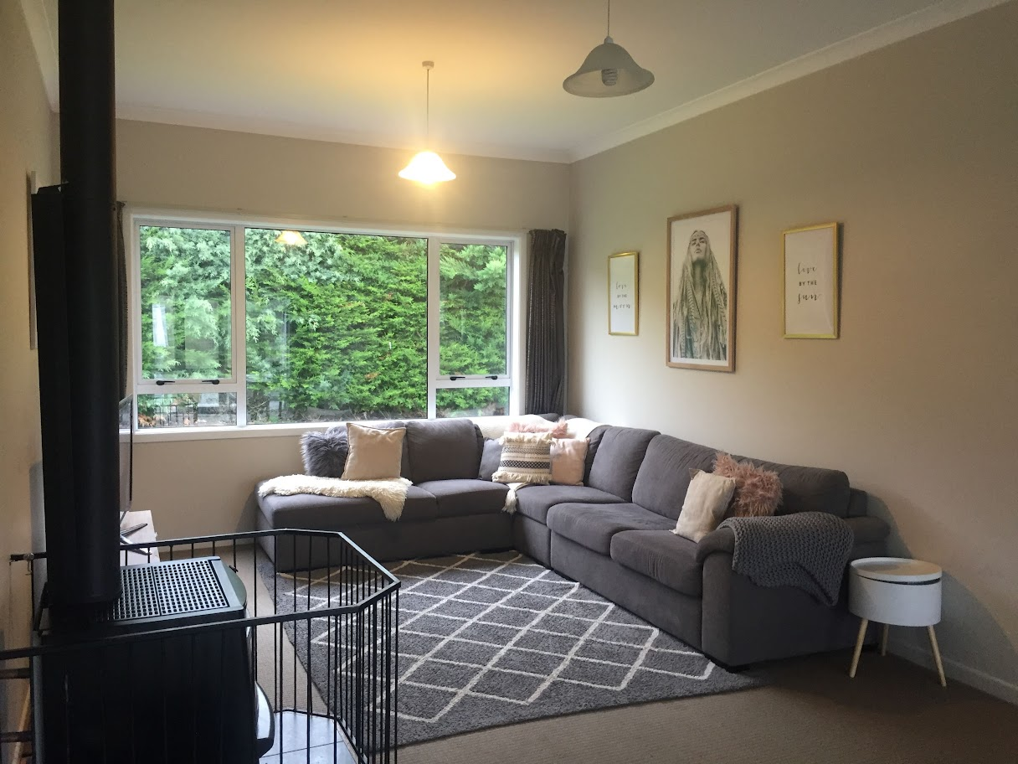
Lounge in the Maud Hooper house

Slide 18
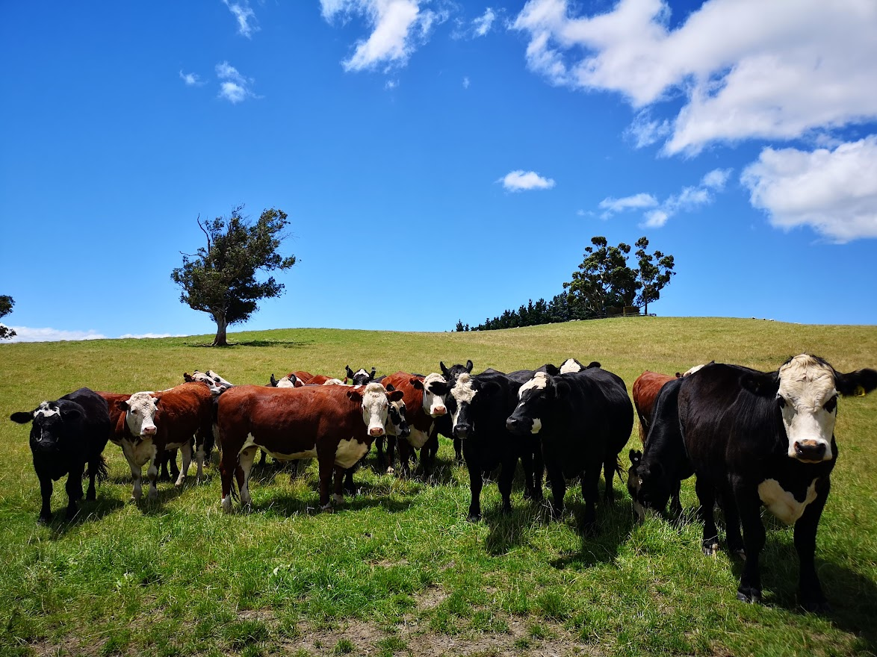
FARMS – CHRISTINA CLARK ESTATE TRUST
Flaxburn – Dairy - South Wairarapa
Granted $200,000 to the PCANZ - 3/4 for Global Mission and ¼ for National Mission – the same as last year
Work commenced on replacing the old homestead
We hope to secure the economic viability of the Flaxburn operation through the purchase of neighbouring land (which we have been leasing for several years)

Slide 19

INVESTMENT
Account balances grew yet again to finish the year at $185m (up from $179 last year)
$142m is invested in the On Call Fund and $43m in the Long Term Fund
We expanded the PIF lending facility to allow parishes to borrow against a presbytery guarantee – at year end 2 parishes had drawn down loans
55% of the PIF is held for parishes, with the remainder split across presbyteries, General Assembly and Church Trusts

Slide 20
INVESTMENT
PIF balances vary across presbyteries

Slide 21
INVESTMENT – PIF RETURNS
It was not an easy year for the Presbyterian Investment Fund
Low interest rates saw the On Call Fund rate begin and end the year at 1.75% - but it fell as low as 1.0% during the period
After returning 14.5% last year, the Long Term Fund suffered as inflation and rising interest rates led to hefty losses in investment markets
As a result, the Long Term Fund lost 5.2% for the year – although account-holders were still able to spend regular interest of 3%
Reserves were used to support returns to account-holders in both the On Call and Long Term Funds
2022 was not a good year for PIF returns – the On Call Fund return remained low and the Long Term Fund lost value

Slide 22
PRIVATE TRUSTS
Total grants from Trusts of $417,158 were made over the year (last year $117,995)
The Nellie Inglis Memorial Scholarship Fund was wound up and over $200,000 distributed to Te Aka Puaho, Pacific and Northern presbyteries
The Vera Wyatt Trust was also wound up and distributed to Northern and Pacific presbyteries
Guidelines and policies were reviewed for the Ministers’ Burnett Loan Fund and Benevolent Fund
The Trustees helped grant over $400,000 during the year, over three times more than last year

Slide 23
PRIVATE TRUSTS - BEQUESTS
Total bequests of $203,963 were received over the year (last year $367,859)
Notable bequests included:
$131,810 from WG Johnson for Knox Presbyterian, Christchurch
$18,609 from R Malcolm for St Paul’s Trinity Pacific, Christchurch
$21,021 from D Riddell for Global Mission
$130,843 from A Anderson (received last year) was distributed to Northern and Pacific presbyteries, the PCANZ White Ribbon programme, and Te Whare Atawhai (Hope House), Christchurch
Nearly $350,000 was distributed from bequests in the year

Slide 24

BENEFICIARY FUND
Membership in the Beneficiary Fund continued to fall, down to 489 (from 501)
After rising last year, members’ account balances also fell to $47.9m (last year $54.6m) reflecting withdrawals and investment losses
The Fund received $1m in contributions (the same as last year) and paid out $3.5m in benefits withdrawn (last year $4.1m)
Fossil fuel exclusions were strengthened within the Fund’s investments
Membership rules for retired ministers undertaking stated supply were relaxed
After strong returns in 2021, investment markets suffered sharp losses as central banks increased rates to combat inflation

Slide 25
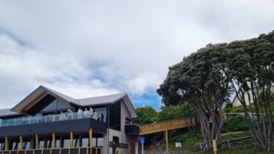
WHAT NEXT?
Work on our “fit for mission purpose” buildings plan will be a key focus – working closely with presbyteries and the Synod of Otago and Southland
We expect the nature of our insurance cover will likely have to change – the Church cannot afford to cover all buildings at reinstatement costs
Both farms have major capital transactions that we expect to conclude during the year
The Beneficiary Fund is exploring a possible replacement for the fee subsidy (which expired this year)
We will be watching inflation and investment return numbers with interest – hoping that they improve
The new Kaikoura development

Slide 26
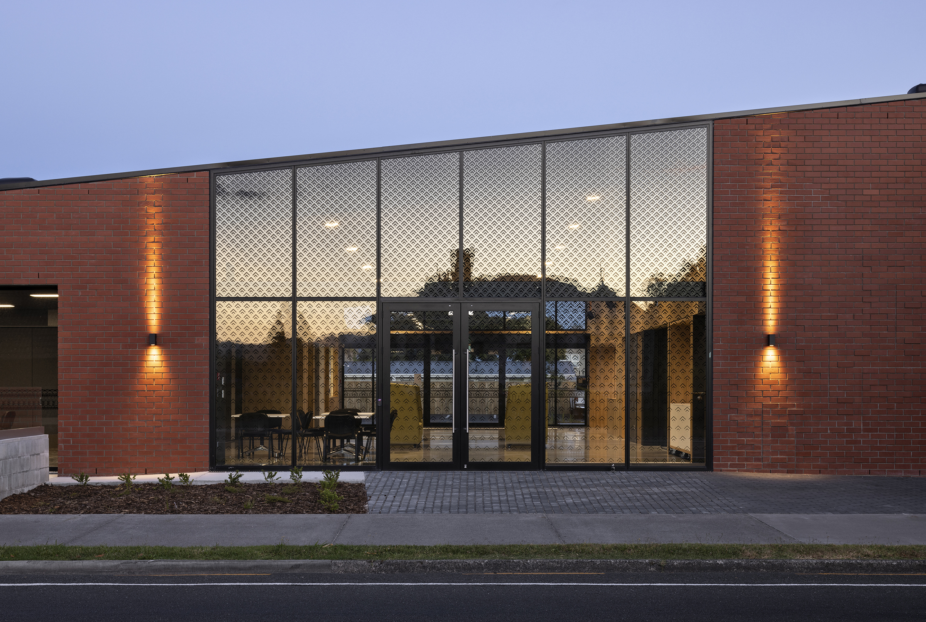
Let’s finish with a look at the fabulous new church building at St John’s, Rotorua . . .

Slide 27
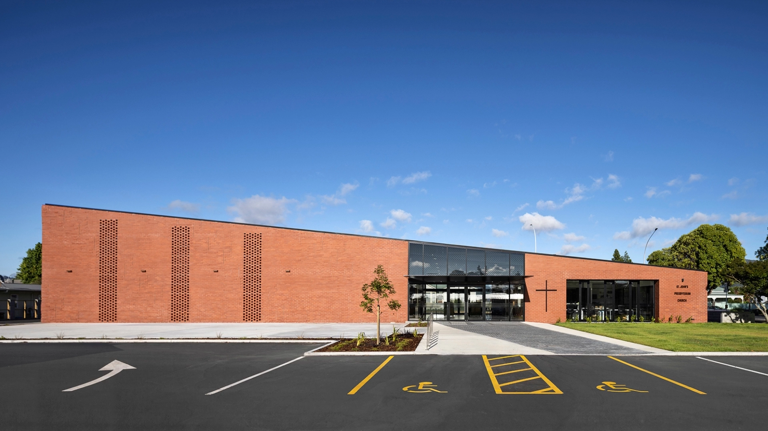

Slide 28
THANK YOU

